Slide 1
Powerful Task Design and Teacher Coaching - A New Way to Evaluate Teachers
Brian McGuire, Ph.D., SAM Principal/Lead Person
John Antonetti, Colleagues on Call
Notes:
Do introductions and then discuss Johns work and how it influenced us. 5 min if table task - John thought:
Task–some data point or reflective question about evaluation influence (Hattie)
Maybe CollTEff, Micro, PD, Teacher Ed, Eval
Reflection

Slide 2
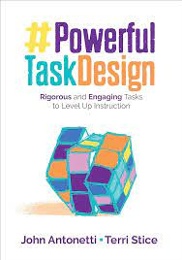

Slide 3
Rank order these “practices” to improve learning
1. Teacher Professional Learning
2. Teacher Education Programs
3. Your Required Teacher Evaluation Process
4. Learning Walks (teachers as walkers)
5. Reflective conversations about a lesson design

Slide 4
Rank order these “practices” to improve learning
4. d= 1.01 Learning Walks (teachers as walkers)
5. d= 1.01 Reflective conversations about a lesson design
1. d=0.44 Teacher Professional Learning d=0.44
3. d=??? Your Required Teacher Evaluation Process
2. d=0.10 Teacher Education Programs

Slide 6
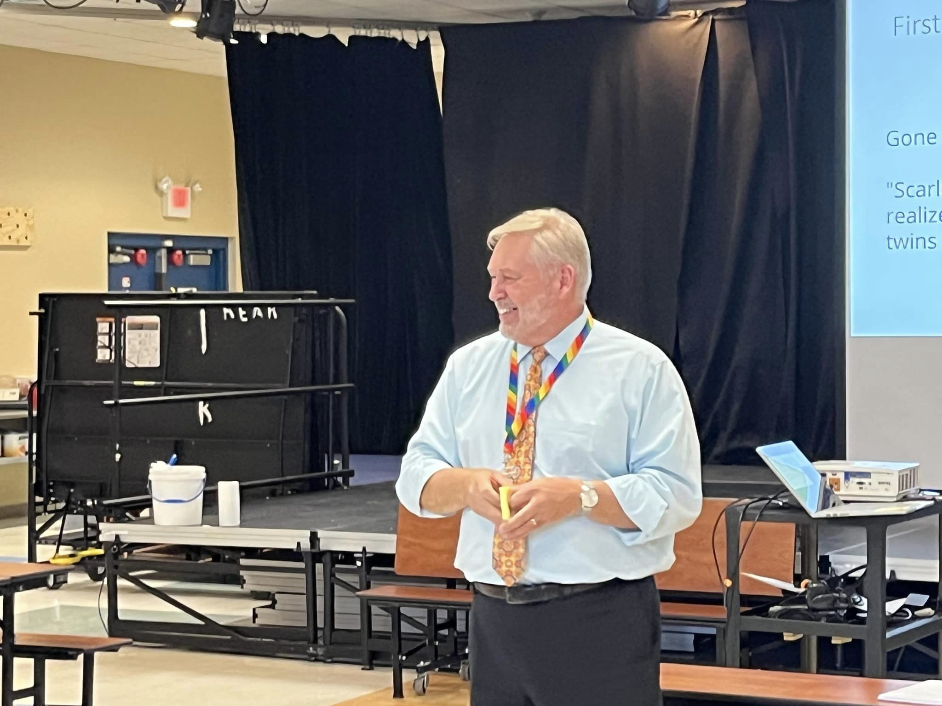
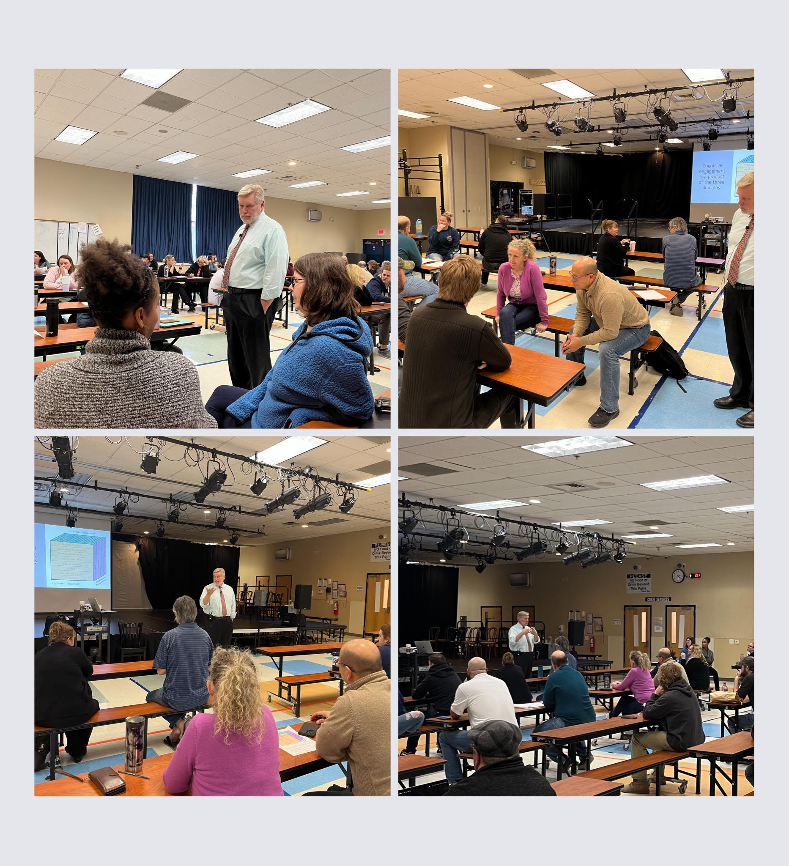
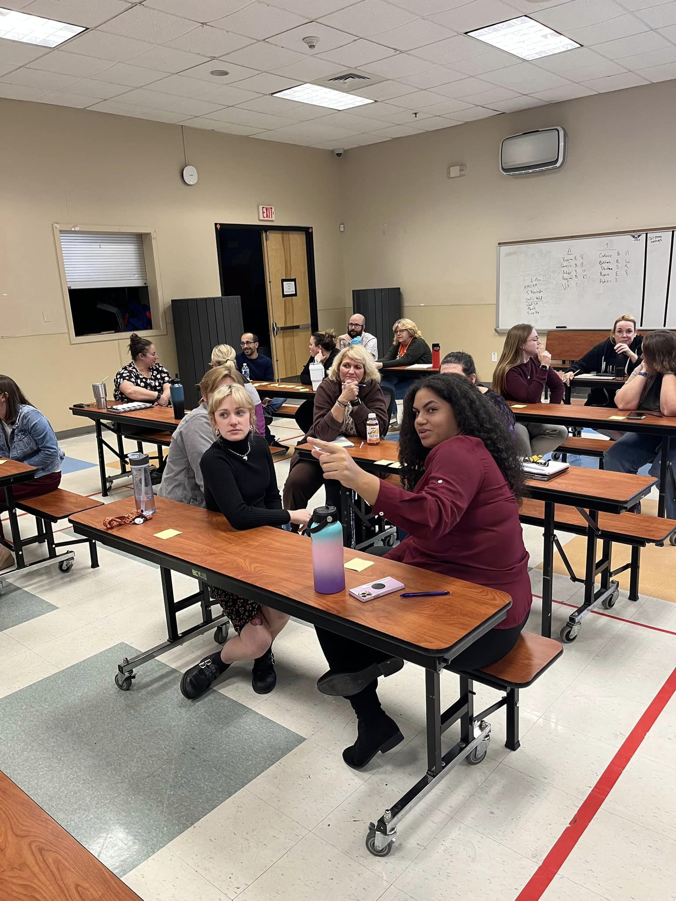
Notes:
John came back and we worked the model…tested interrater reliability, and changed some things. MAIN FOCUS WAS THE TASK DESIGN. Here are some more thoughts from the teachers about the change…

Slide 7
Notes:
Q1 Antonetti (Tell me about your experience with Professional Development from John Antonetti)

Slide 8
THEN….
observation season was about to begin.
Notes:
We have this great work going yet our former observation model just doesn’t seem to fit. Teachers got together and Vavra came to me to discuss making a change.
I agreed. And then, we went to work - a collaborative effort among teaching faculty, administration, and John Antonetti.

Slide 9
I asked my teachers their thoughts about evaluations…
Some educators say that teacher evaluation does not matter. What would you tell them?
This is what they said…

Slide 10
Notes:
Q4 (Some people say that teacher evaluation does not matter. What would you tell them?

Slide 11
So, what did they say when I gave the greenlight about moving away from the former model??

Slide 12
Notes:
Q3 (How did you feel when you heard that we were moving away from our former observation model?)

Slide 13
FOR THE RECORD:
It was not an argument.

Slide 14
What happened next?
We put a team together to build a better model - one that matched the work.
There were many, many versions.
But, at its core - three things were most important…
Notes:
3 minute TASK John thought: revisit ranking of influences

Slide 15
Notes:
Vavra - take care of your shit.

Slide 16
Make stuff worth doing for the kids.
Be good to your kids.
Take care of your sh*t.
Translation:
Instructional Task Design
Teacher-Artist Interactions
Professional Responsibilities

Slide 17
Link to the online model!
Teacher Collaborative Evaluation Model
Notes:
Can we use this moment to synthesize or replace some of the earlier explanations? OR Do this earlier and then not need some of the other slides?

Slide 18
Notes:
Q3A (Expanded thoughts from faculty)

Slide 19
Instructional Task Design
Notes:
7-10 min (Careful John–what is the fastest way for people to get this–a vocab, a slow reveal, an excerpt (Scarlett O’Hara versus the whole novel) (or the line from about the hot road and my brother —see excerpt book in office or from Horry GT one of the days) Lead in to the next video…TASK design section of model thoughts - A simple math graph and then the +1 slow reveal with collaboration

Slide 20
A tale of three tasks and the +1
List the 5 rights guaranteed by the First Amendment to the U.S. Constitution.
Draw a picture of one of the rights.
Take away one of the rights… and go back in time…
Notes:
7-10 min (Careful John–what is the fastest way for people to get this–a vocab, a slow reveal, an excerpt (Scarlett O’Hara versus the whole novel) (or the line from about the hot road and my brother —see excerpt book in office or from Horry GT one of the days) Lead in to the next video…TASK design section of model thoughts - A simple math graph and then the +1 slow reveal with collaboration

Slide 21
Martin Luther KingMartin Luther King Jr.’s “I Have a Dream” speech on the National Mall.
The Washington Post uncovering the Watergate scandal.
Women gaining the right to vote.
The Washington Post uncovering the Watergate scandal.
Women gaining the right to vote.
Notes:
7-10 min (Careful John–what is the fastest way for people to get this–a vocab, a slow reveal, an excerpt (Scarlett O’Hara versus the whole novel) (or the line from about the hot road and my brother —see excerpt book in office or from Horry GT one of the days) Lead in to the next video…TASK design section of model thoughts - A simple math graph and then the +1 slow reveal with collaboration

Slide 22
John came back to school to meet with the team, collaborate on the model, and conduct the field tests.

Slide 23
Notes:
TASK DESIGN

Slide 24
Pre-Conference Questions
What is your focus standard? Are there any supporting standards?
What do you want the Artists to learn?
What is the task(s) through which they will achieve this learning?
How will the Artists demonstrate their understanding?
Is it a task of PRACTICE? Or, is it a task of THINKING? Where does the task fall on the Powerful Task Matrix?
Are you planning on crossing the RIGOR DIVIDE?
How is your task using the ENGAGEMENT CUBE?
What do you want most from this lesson?
Notes:
Conversation not checklist - This is important?
Maybe a task of compare to your model at home?

Slide 25
Workflow…
Observe the class.
(During the class we take notes, etc. and start to fill out the discussion tool.)

Slide 26
Workflow…
Hold the Post Conference.
During the Post - We use a simple Google Doc Version of the model - the “discussion tool”
WHY?

Slide 27
Workflow…
Once all is discussed and agreed upon (not always!)
Copy/Paste into the online form.
The form is automatically sent to the teacher for signature and comment.

Slide 28
What does the faculty think about the new model?
Notes:
Maybe A fast reflection task about how do you think teachers would respond?

Slide 29
Notes:
Q5 (What is your opinion of the new model?)

Slide 30
How this new model differs from others…

Slide 31
Notes:
Q6 (How this model differs from others)

Slide 32
Efficacy!!

Slide 33
Notes:
Efficacy

Slide 34
Other teacher comments…

Slide 35
Observation Feedback Notes 10/31/23
First, I am overall happy with the observation tool. I feel as though this observation tool has helped me to look at the way in which I approach review information. I feel like the Artists got a better handle of the information.
I then went to the grades on the quizzes and looked at the percentage increase. The number of Artists whose grade went up on the second quiz was 13 out of 18. The largest increase went from 77% to 92% and that was a 19.4% increase!
After looking at the data for the first and second quizzes for A Doll’s House, the average score on the quiz went from a 77% to an 82% (a 6% increase). It seems that looking at the Cube and the Rigor Divide has helped the Artists increase the skills needed to be successful on the assessment. Additionally, all of the classes showed an increase in score after completing the review task.

Slide 36
Notes:
Final comments from teachers

Slide 37
Exit ticket–
What is the +1 for your current system

