Slide 1
An Hour conversation with Dr. phil! Phil backlund
Empowering
leadership

Slide 2
THE HOUR INCLUDES:
My background and how I happen to be here
About power
About empowerment
About empowering

Slide 3
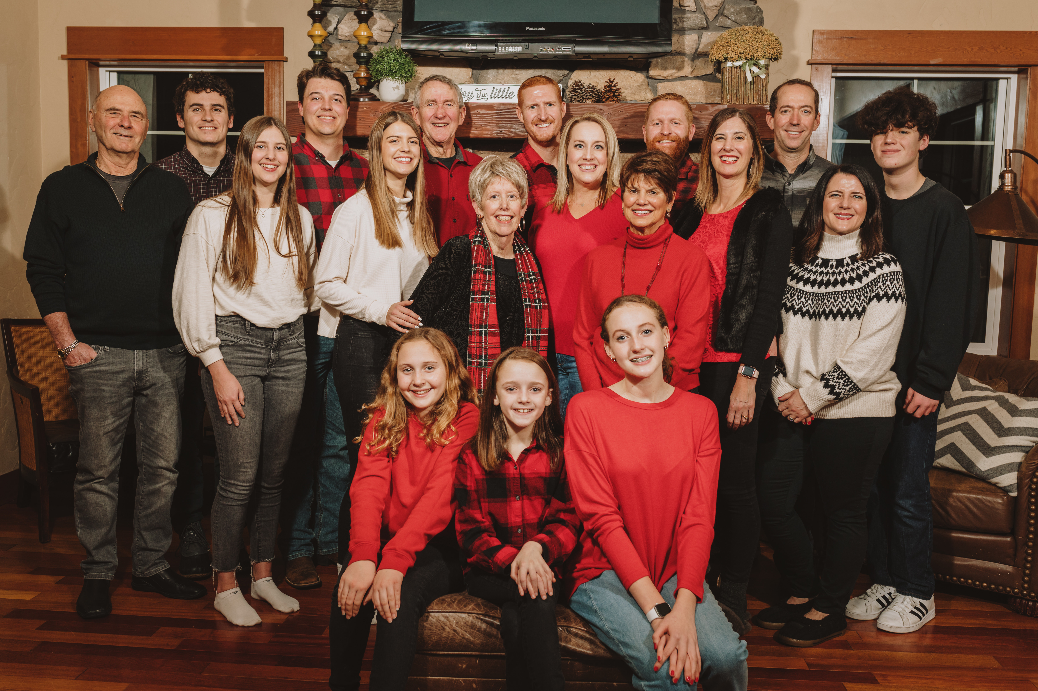
about me
Family
University
Traveling
Consulting

Slide 4
empowering leadership
Giving power
As a parent
As a teacher/admin
With my brother

Slide 5
ABOUT POWER
Power: THE ABILITY TO Influence, ability to change thinking or behavior
Types of power
Forceful power-power over;
reward power-power to give;
legitimate power-power due to position;

Slide 6
POWER TYPES
referent power-power based on connections;
expert power—power based on knowledge;
persuasive power—power through words;
nutrient power-power to develop

Slide 7
Nonverbal POWER
Influence by actions
*responsiveness
*proxemics
*Eye contact
*vocal tone

Slide 8
About empowerment
Basic point—Increase their ability to change something.
Andrew Carnegie, work yourself out of a job
If you give them power, they must be able to change your mind.

Slide 9
Efficacy
The Belief that we can do it
Our kids
My students
Do people believe talking to you is worth the effort?

Slide 10
About empowerment
We give some power away.
We mentor people to do things they thought not possible.
We believe potential. We are radical encouragers.
We look for the gold.
We like people.
People feel valued around us.
We create an empowering environment.

Slide 11
Cautions About empowerment
Problems with this point of view?
What about boundaries?

Slide 12
About empowering
coercive power—Give them the power to be assertive
reward power—help them develop rewards for others
legitimate power—enhance or give them position authority
referent power—pull them into helpful relationships

Slide 13
About empowering
expert power—develop their knowledge
persuasive power—help them develop persuasive speaking and writing.
nutrient power—help them develop ways to develop people

Slide 14
About empowering
Giving them knowledge and skill.
Beliefs
Language
Creating culture
Choosing who to empower
People from other cultures
Empowering listening
Empowering meetings
Empowering speaking
Empowering conflict management

Slide 15
empowerment
Summary
Think about it

