Slide 1

Become a Data Knight
Using TimeTrack Data, Charts & Graphs,
to further reflect on how and whether time is making a positive difference in teacher practice.
Debra Sykes
Time Change Specialist & Coach
Notes:
Data Literacy Project --4 levels of data use
How you use your TimeTrack to improve your practice is an ever-evolving process.
When you first begin it is about:
scheduling your time to meet a predetermined instructional goal for each month/day
selecting the better descriptor for what you are scheduling
setting the names of individuals/groups you are scheduling time with
And you know some sort of data is being collected in graphs.
But at this point you don’t know what you don’t know.
Things you might need to know but didn’t know to ask for.
Ask your TCC to guide you and/or use the data resources – written tools for SAM Teams.
It is important to figure out how to use TT for intentional reflection to help leaaders grow in thier practice as a leader.
Can you look at your data and answer the question; “Is this teacher/person better because of the time you spent with him/her?”
.

Slide 2
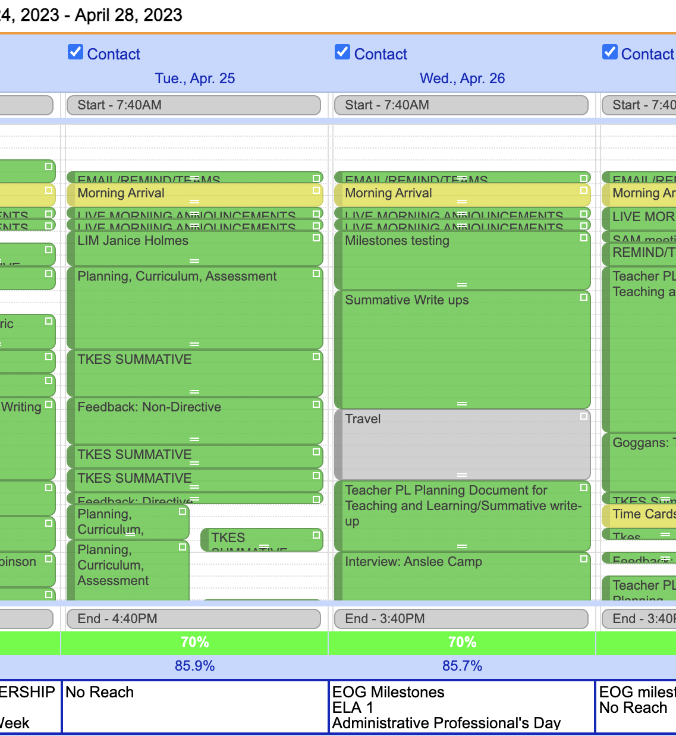
TimeTrack is…
  really a database
  disguised as a calendar!
Notes:
Have you considered this idea? What’s your why? Purpose?

Slide 3
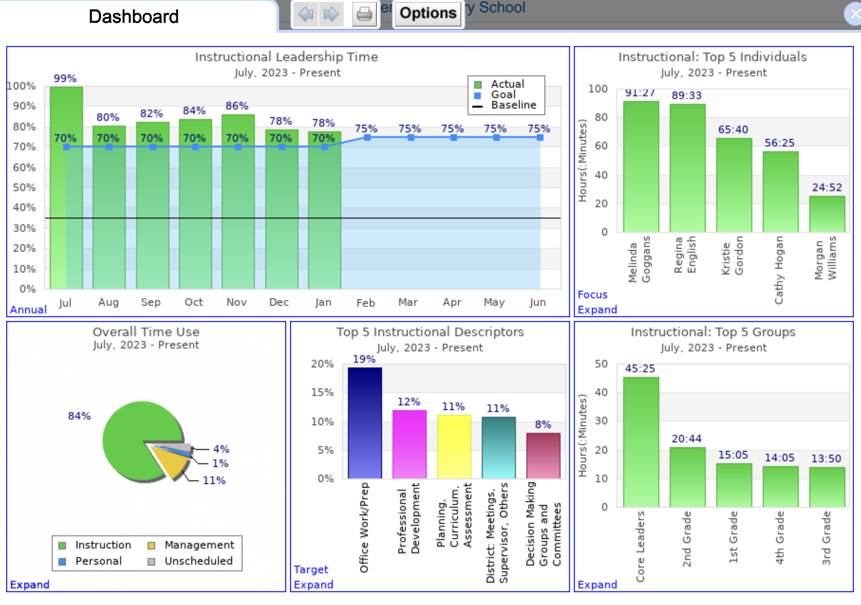
TimeTrack
Dashboard
SPEED ANALYSIS
Notes:
aggregate data in TT

Slide 4



Slide 5
Becoming Data Literate timetrack
Read
Read Data – which means understanding what each graph represents and the aspects of the time and instructional work it represents.
Work
Work With Data – managing it by scheduling events, reconciling events, creating optional descriptors, and cleaning it.
Analyze
Analyze Data – which involves filtering, sorting, aggregating, comparing, and performing other analytic operations on it.
Argue
Argue With Data – which means using data to support a larger narrative that is intended to communicate some message or story to a particular audience.
Data Literate
In order to be a Data Knight, you have to be verbally literate, numerically literate, and graphically literate.

Slide 6

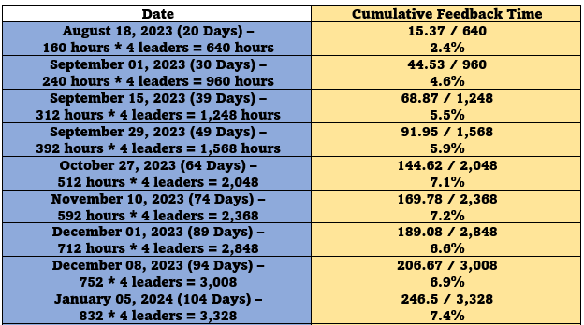

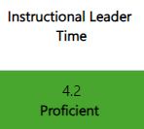
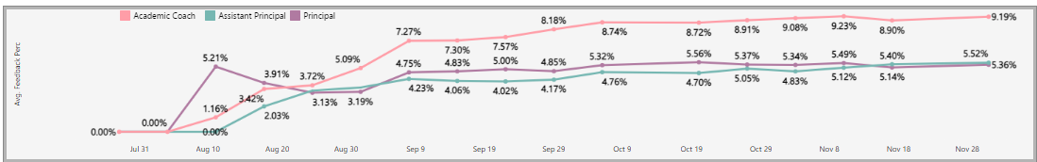
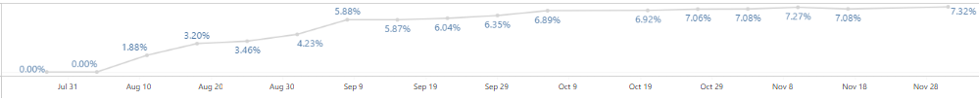
Strategic Goal Area #2: Staff Effectiveness:
P4: Effectively Manage All Operational Procedures and Resources
C
Strategic Goal 2: All employees will excel daily in the performance of their roles to ensure our district thrives.
Smart Goal #1: Maintain the % of staff with a proficient or higher evaluation (Annual) at a school average of 98% in 2023 to no less than 95% in 2024.
Action Step #1: Continue the expectation that each time an observation/walkthrough is held, immediate, specific celebratory and growth feedback is provided.
Implementation (Lead) Measure
Universal Feedback – Celebratory & Directive/Non-Directive Feedback)
Impact (Lag) Measure
Last Updated 11/23
Average % of Instructional Leader Time Spent on Providing Feedback
7.3 Proficient
Last Updated 12/11/23
7.2%
Notes:
An example – we will not be doing this in today’s 60-minutes but you do have a TTC who can take you to using your data at this level.

Slide 7

TimeTrack Data
AGGREGATE
VS
DISAGGREGATE
Aggregate data combines and summarizes information, whereas disaggregate data separates aggregate data into specific points or pieces of information to often reveal underlying trends and patterns.
Notes:
To aggregate data is to compile and summarize data; to disaggregate data is to break down aggregated data into component parts or smaller units of data. While this distinction between aggregated and disaggregated data may appear straightforward, there is a nuance worth discussing: a lot of “disaggregated” data in TimeTrack is actually data that has been technically aggregated, at some level. When investigating or reporting on topics such as aggregate data or disaggregated data, it is important to determine precisely how the terms are being used in a particular context.

Slide 8
Aggregate Data
Aggregate data in TimeTrack refers to the information that is collected from:
scheduling
setting associations
reconciling events
and compiled into a data summary form in the Dashboard’s graphs and reports under two areas; instructional and management.
These graphs and reports can be used for general analysis and understanding of time spent data.
They can help the TimeTrack user to reflect and make informed decisions about where to spend time.
Notes:
While aggregate data such as … can yield a variety of important insights, …the importance of disaggregating data to expose underlying trends and issues such as…
Generally speaking, the main purpose of collecting and reporting aggregate data is to provide useful information about the leader’s instructional time. While aggregate data are essential to understanding where the leader is spending their time, aggregate-data reports are generally limited to the identification of broader trends and patterns in time spent; they are not as useful when it comes to diagnosing deeper underlying patterns and trends, such as ….

Slide 9
TimeTrack
Dashboard

Slide 10
Disaggregate Data
Disaggregate data in TimeTrack refers to the process of using the OPTIONS tab to filter the data into smaller units and/or subgroups.
Date range
Category/descriptor/optional descriptor
Select individuals/Groups
The disaggregated graphs and reports allow for a more detailed analysis and understanding of the data for one or more users.
They can help the TimeTrack user to reflect and make informed decisions about where and how to spend time.
Notes:
Although most people are not aware of it, the key to finding the root cause of many problems is to “disaggregate” an aggregate number.
So how do you disaggregate data? First, find relevant sub-aggregates or subgroups. This requires thinking and knowledge of the particular situation

Slide 11
Written Tools for SAM Teams
Data Series Documents
Data Series 1 Instructional Leadership Time
Data Series 2 Top 5 Instructional Descriptors Part 1
Data Series 2 Top 5 Instructional Descriptors Part 2
Data Series 3 Top 5 Individuals
Notes:
Go to live data.

Slide 12
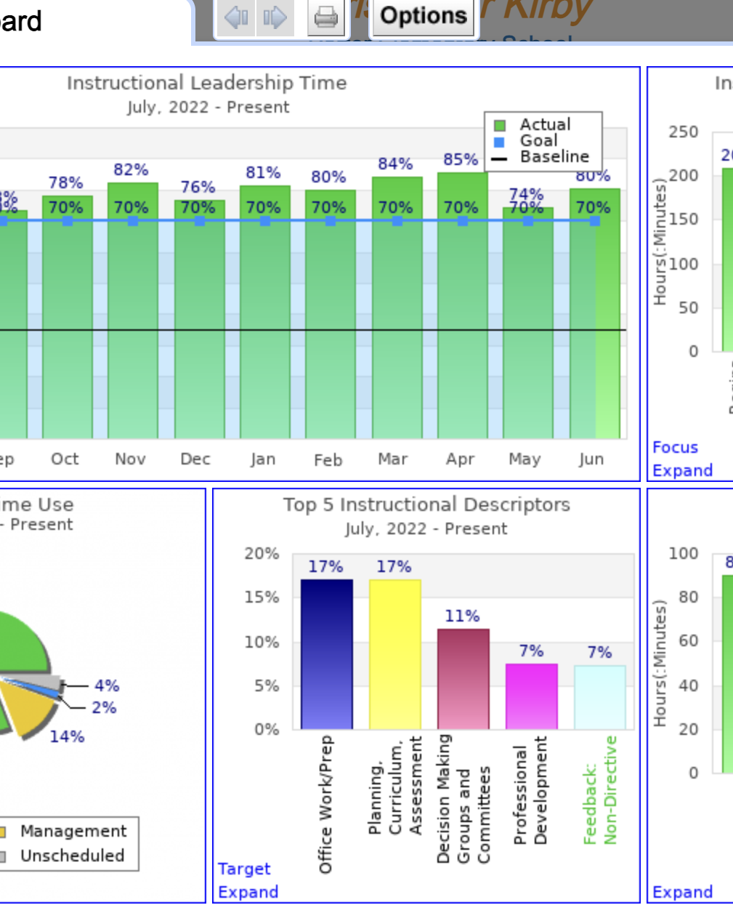
How Do You Begin to Determine the which Data to choose in TimeTrack?
Start by –
Clearly define the question the user is trying to answer.
Determine which graph or graphs will be used.
Ensure that the data collected are appropriate for that purpose.

