Slide 1
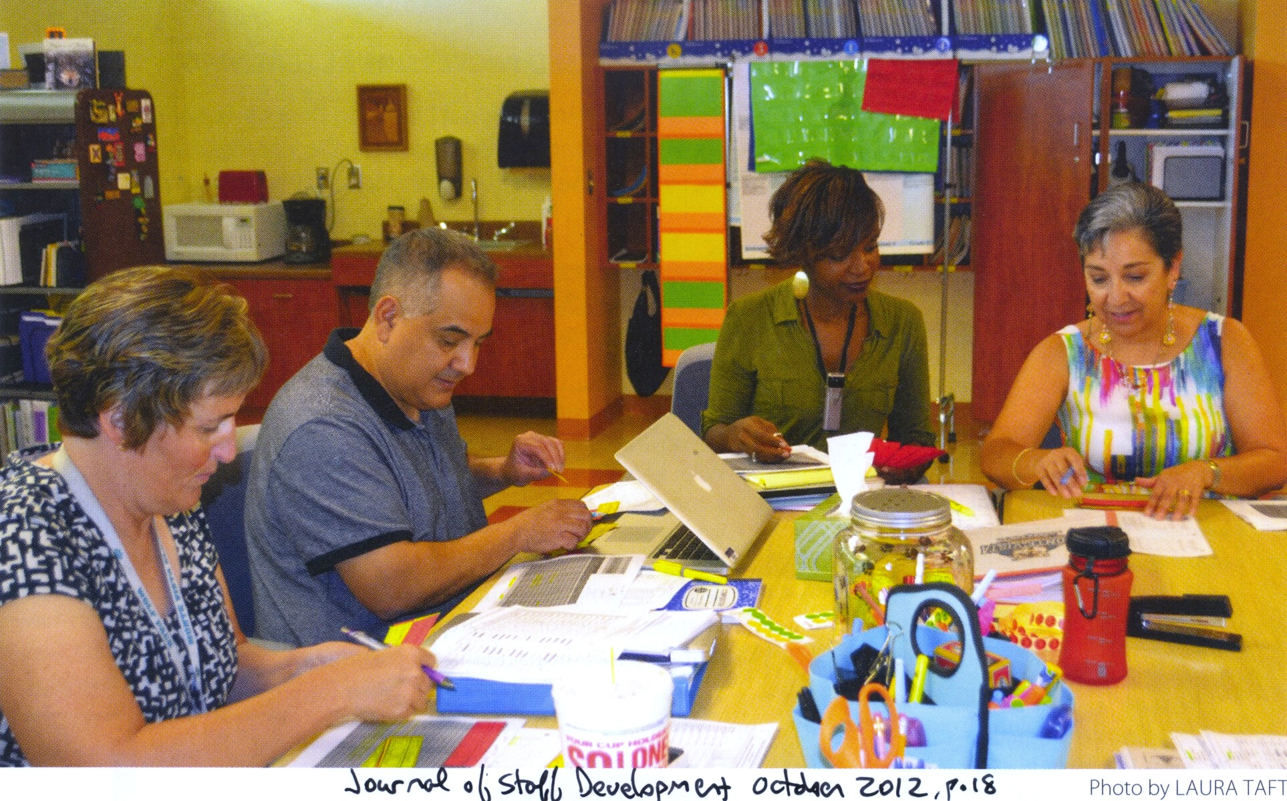
AVOIDING “PLC LITE”
SAM Fort Lauderdale – Kim Marshall – January 26, 2024

Slide 2
Time travel: Boston’s King School, 1975
A common October math test for our ten 6th-grade classes?
What would we as teachers have wanted?
  Advance notice of content, rigor, type of questions
  Fair, high-quality questions
  Time to teach, materials, support
  Time to score and analyze
  Time to discuss the results
  Medium stakes

Slide 3
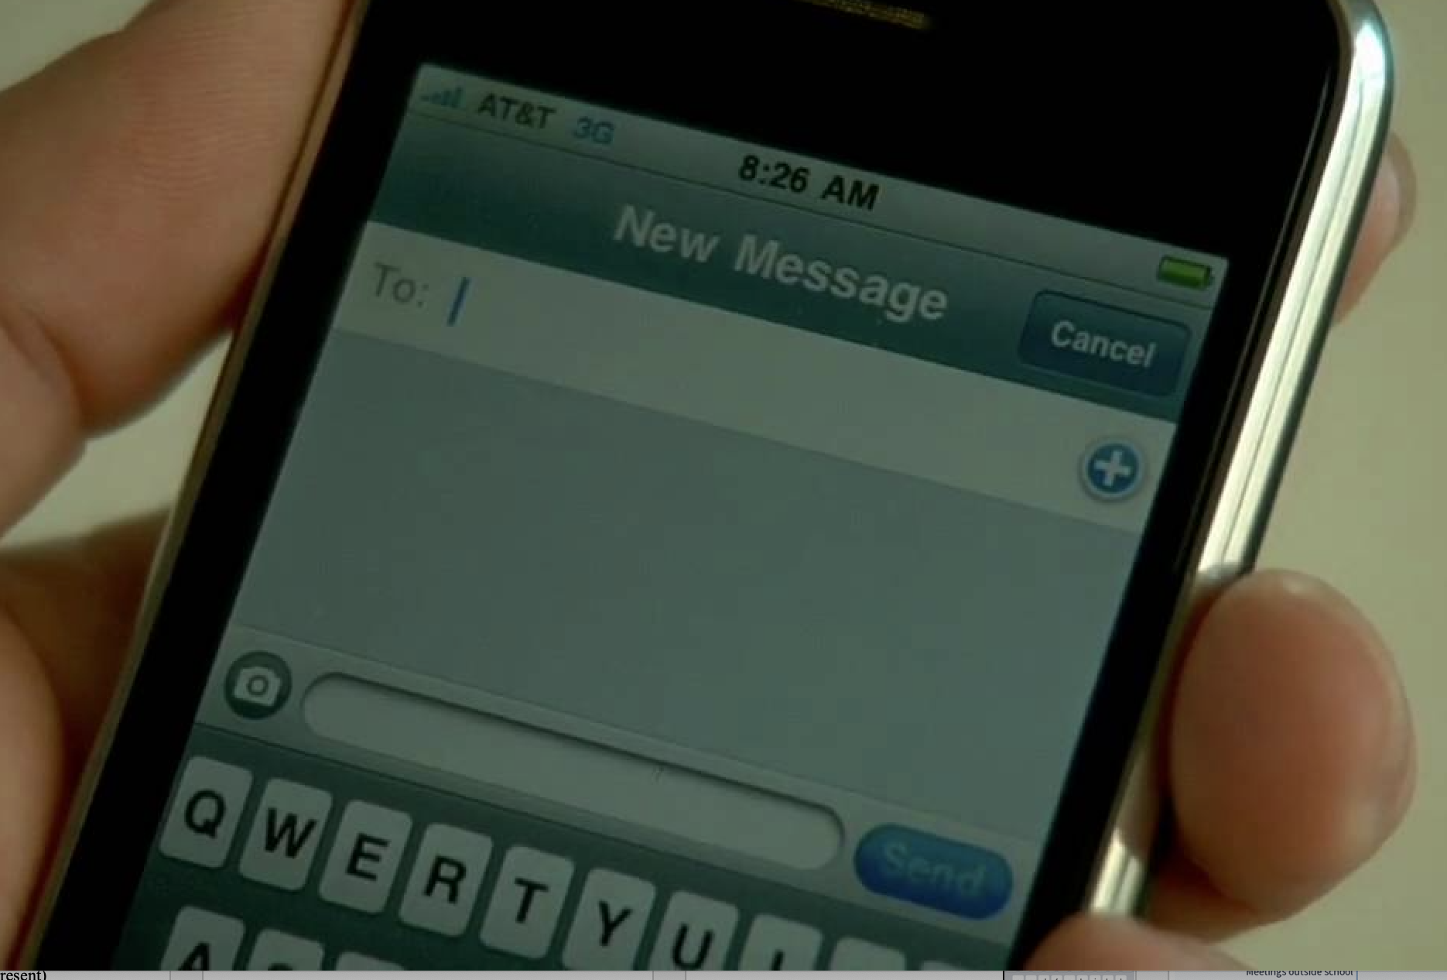
Poll Everywhere setup
Enter a new text:
To: 37607
Message: Kimmarshall346
Send
--------------------------------------------------------
Website browser option: pollev.com/kimmarshall346

Slide 4
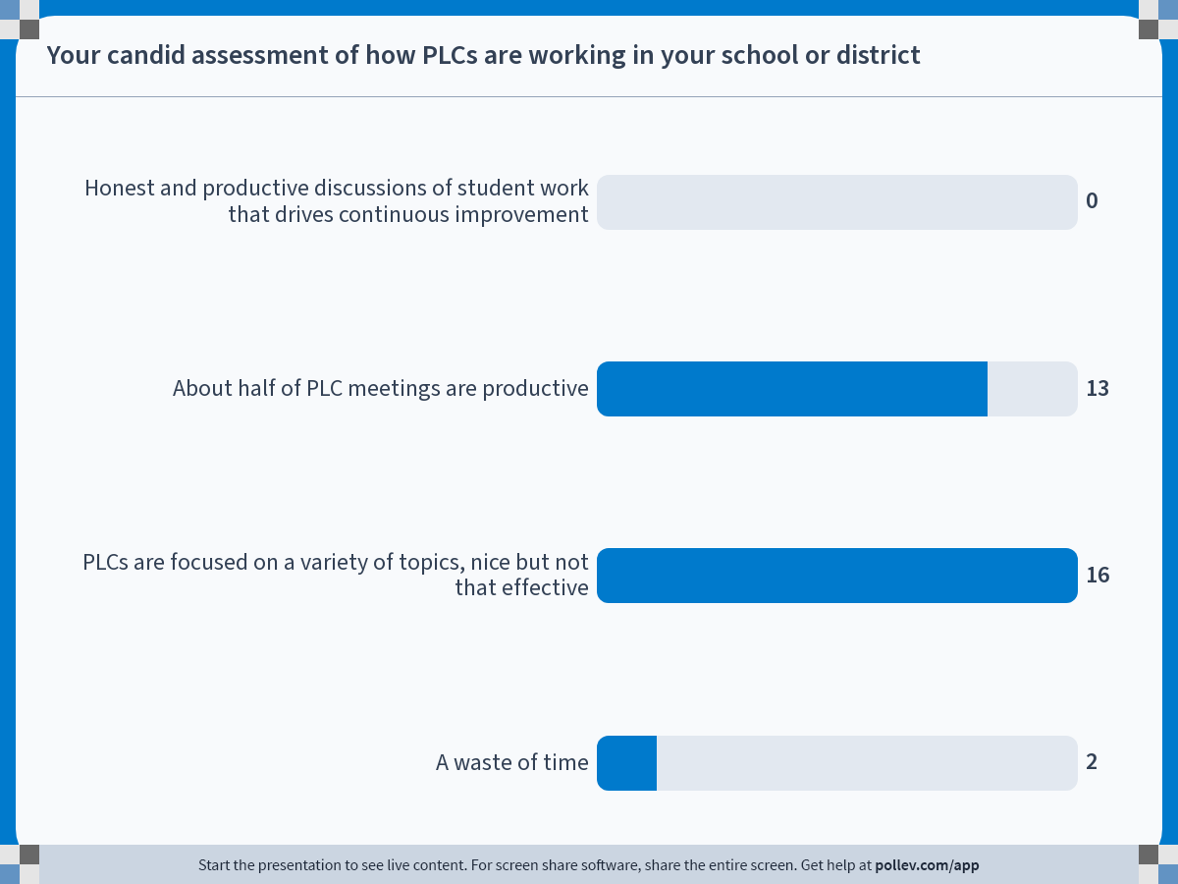
Notes:
Do not modify the notes in this section to avoid tampering with the Poll Everywhere activity.
More info at polleverywhere.com/support
Your candid assessment of how PLCs are working in your school or district
https://www.polleverywhere.com/multiple_choice_polls/KI58PBP7qgaI3ONWXzCVy?state=opened&flow=Default&onscreen=persist

Slide 5
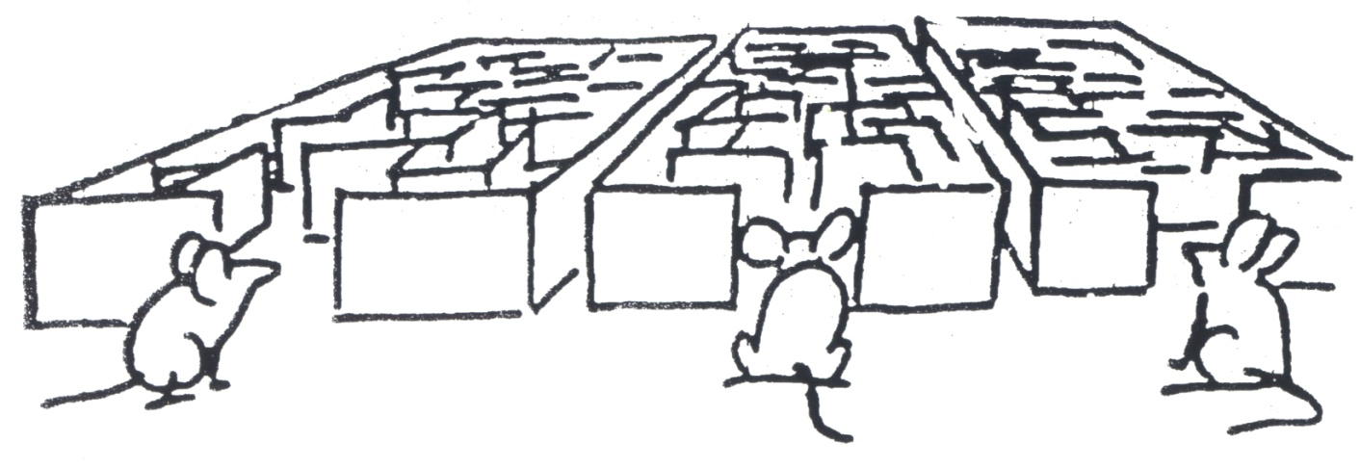
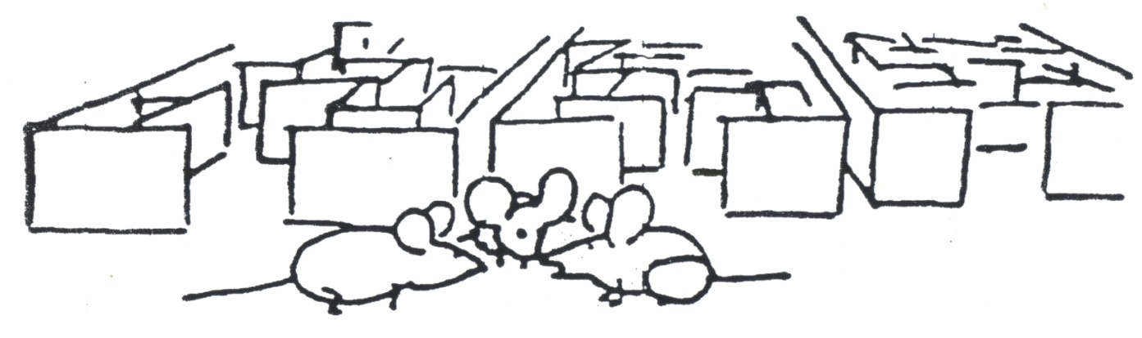
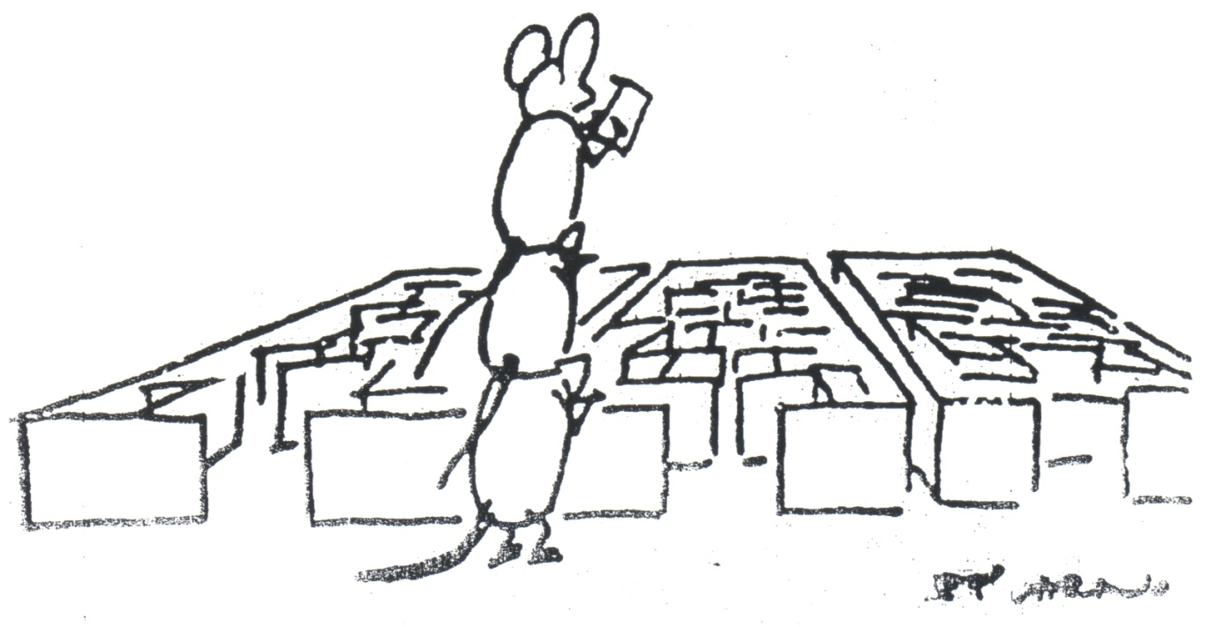
What’s the
problem
to which
PLCs
are the
solution?

Slide 6
Three kinds of assessment
Formative?
On-the-spot
Interim, unit
Summative

Slide 7

Interim, benchmark, periodic, common formative assessments

Slide 8

Andon cord on auto assembly line
Workers who spot defects are empowered to stop the line.
They give feedback up the line to prevent repetition
Actually speeds up the line
Small wins
Continuous improvement

Slide 9
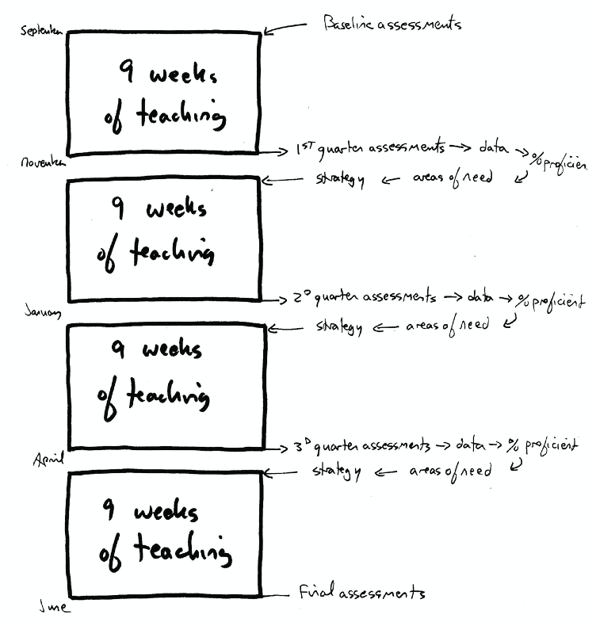

Slide 10
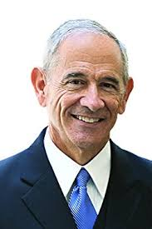
Rick DuFour’s PLC questions
1. What do we want each student to learn?
2. How will we know when each student has learned it?
3. How will we respond when a student experiences difficulty in learning?
4. And if they already know it?

Slide 11
Which students know what?
What are we going to do about it?
Tony Flach, 2022

Slide 12
Sounds easy. Guess again!
If it were easy, all schools would be above average.
Interim assessments “haven’t traveled well.”
A few educators get it, most don’t.
What could go wrong? What has gone wrong?

Slide 13

Teachers
fear
“Gotcha”
Slow
turnaround
Teams
don’t
meet
Weak follow-up
with students
High achieve-ment for all students
Good
use of
assess-ments
Not well
aligned to
standards
Not
frequent
enough
External
scoring
The “culture
of nice”

Slide 14
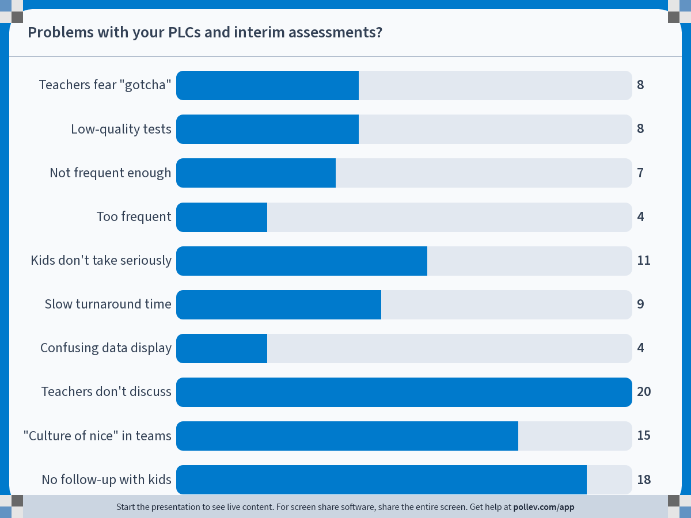
Notes:
Check any problems with your interim assessments:
https://www.polleverywhere.com/multiple_choice_polls/yNuvmnCCK0Gf4qvkDibqi?flow=Default&onscreen=persist

Slide 15
Ten key steps
Building understanding and trust
Clarifying learning outcomes
Setting a long-term goal, SMART goals
Getting good interim assessments
Scheduling assessments and immediate follow-up
Teacher scoring and analysis
Effective data display
Holding data meetings and planning for action
Involving students
Relentlessly following up with students

Slide 16
Would you like these slides?
If so, please e-mail me: kim.marshall48@gmail.com

Slide 17
A. Building understanding and trust
Teachers aren’t crazy to worry.
Central-office data collection
Resistance to testing
“Teaching to the test”
“Just let me teach!”
Fear of looking bad

Slide 18
Change moves at the speed of trust.
Stephen Covey

Slide 19
A learning curve in Georgia (Memo 78)
Camden County, interim assessments every 9 weeks
Phase I – Confusion and overload: “This is too much!” “I was hired to teach, not do statistics.”
Phase 2 – Feeling inadequate and distrustful. “I don’t teach that way!”
Phase 3 – Challenging the tests – “Trick questions”
Phase 4 – Looking for causes, patterns, takeaways
Phase 5 – Accepting the data as useful for instruction
Between 1997 and 2002, went from very low to 10th

Slide 20
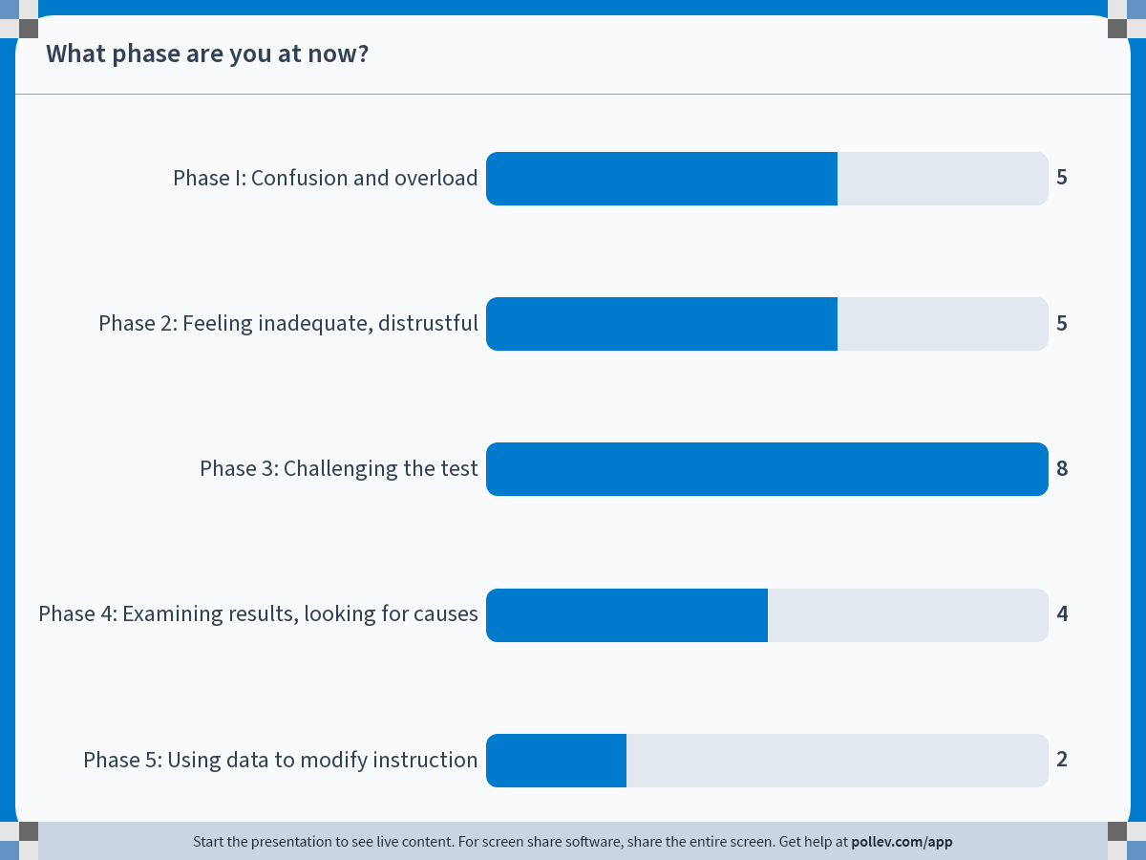
Notes:
What phase are you at now?
https://www.polleverywhere.com/multiple_choice_polls/QQ5ym06V8NS6vj1Qy8Hjj?flow=Default&onscreen=persist

Slide 21
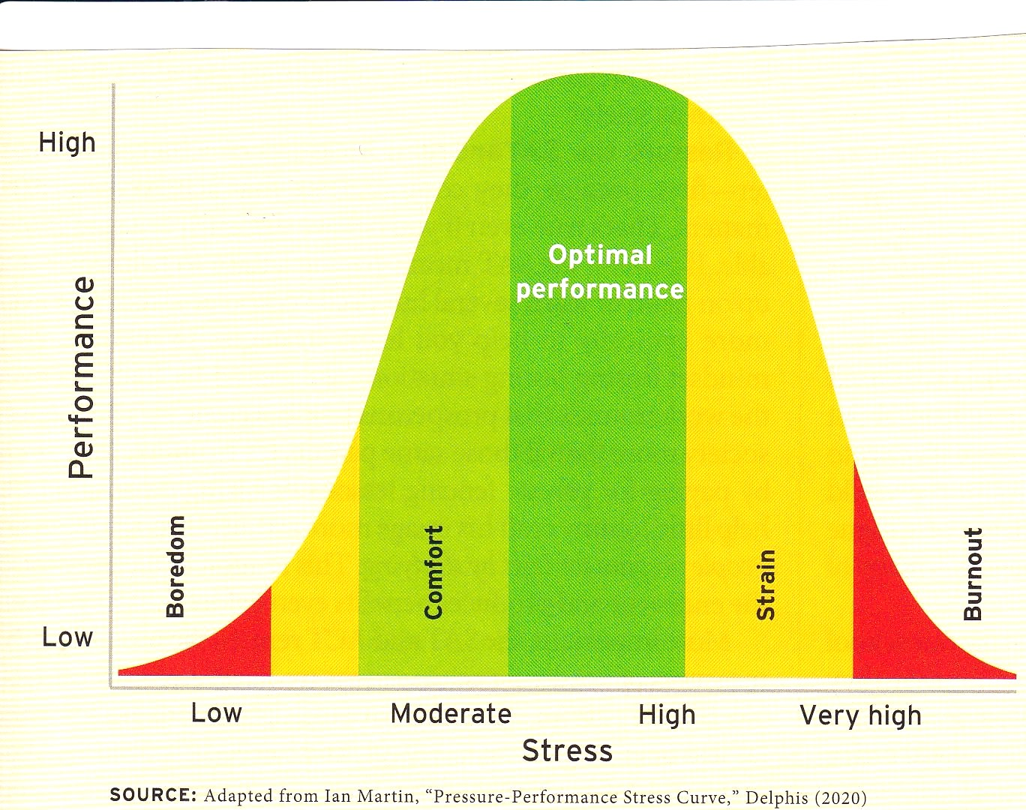
Yerkes-Dodson Law

Slide 22
Building psychological safety
“We have the power to drive people crazy.” (Mary Nash)
Explaining the logic - why are we doing this?
Interim results not part of teachers’ evaluations.
Teachers see assessments in advance (trust).
Teachers involved at every stage of the process
“Data without blame” ethos in meetings

Slide 23
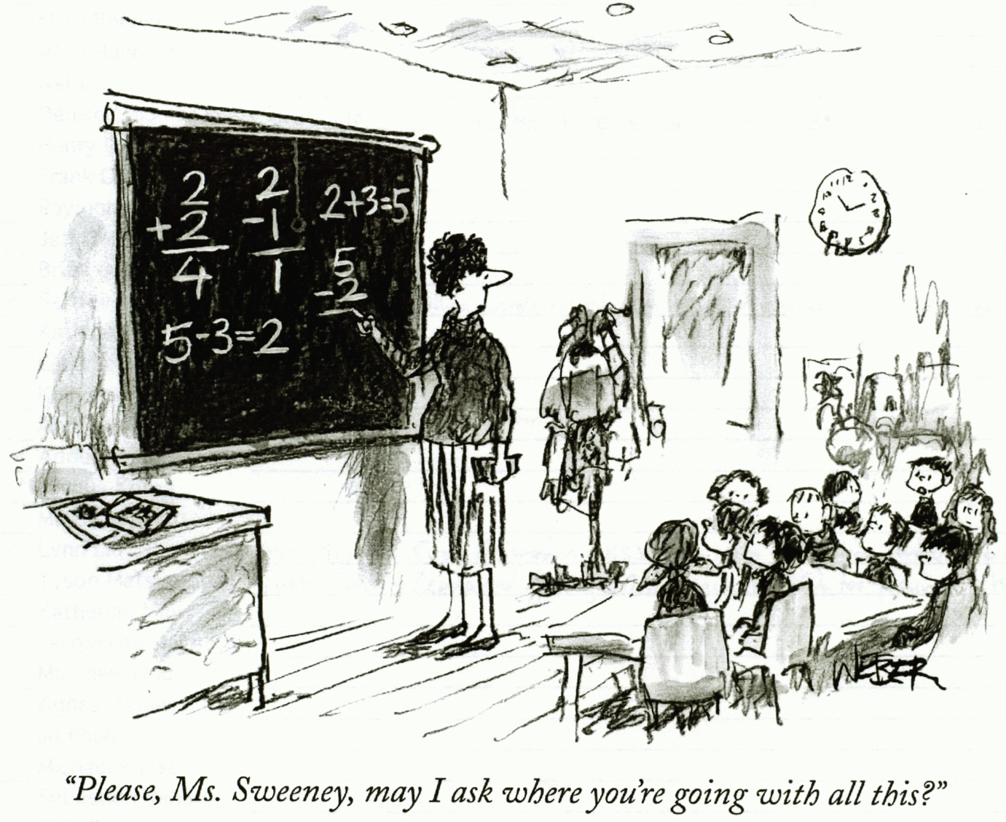
B. Clarifying learning outcomes

Slide 24
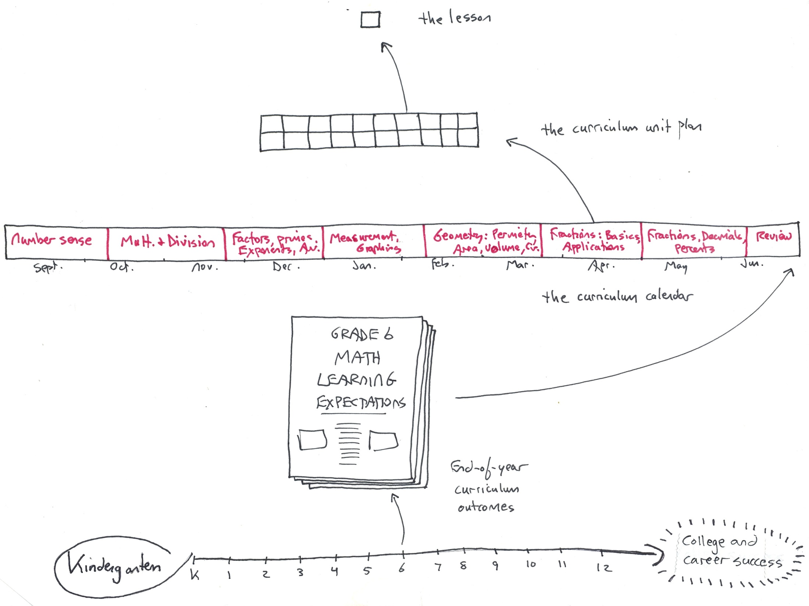

Slide 25
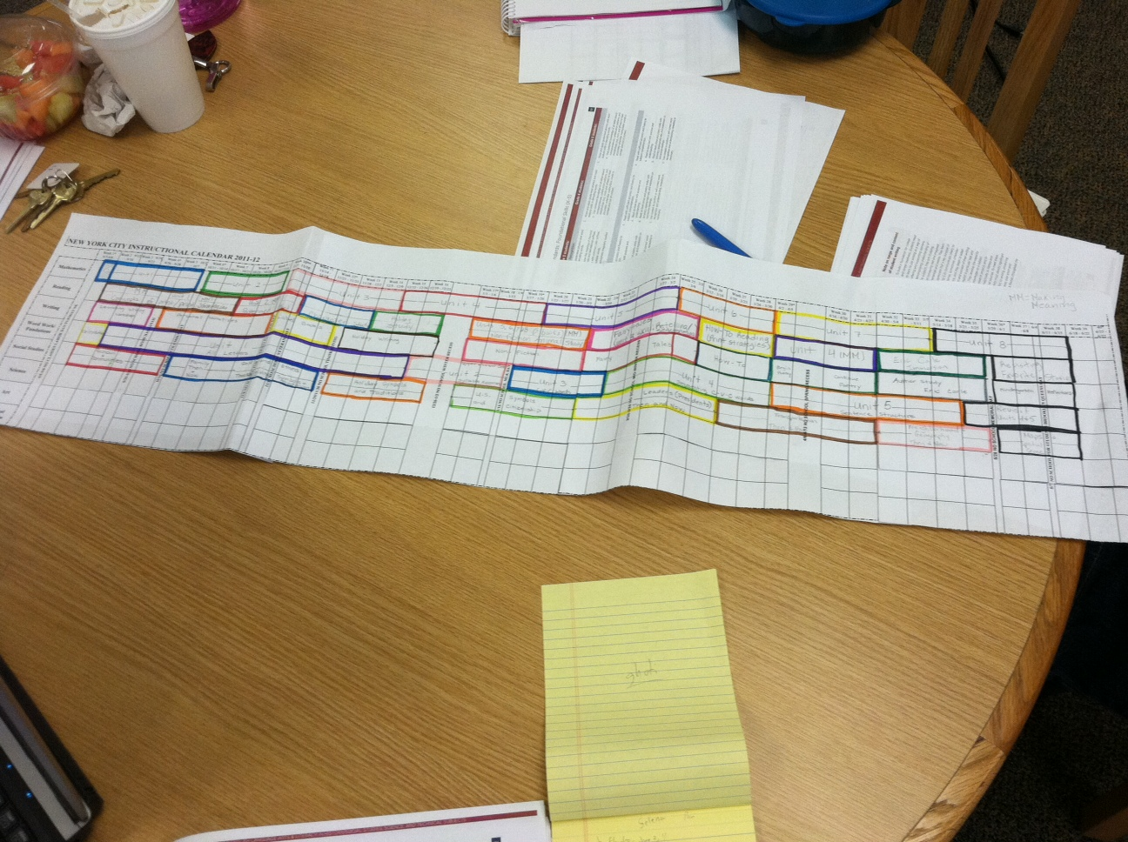

Slide 26

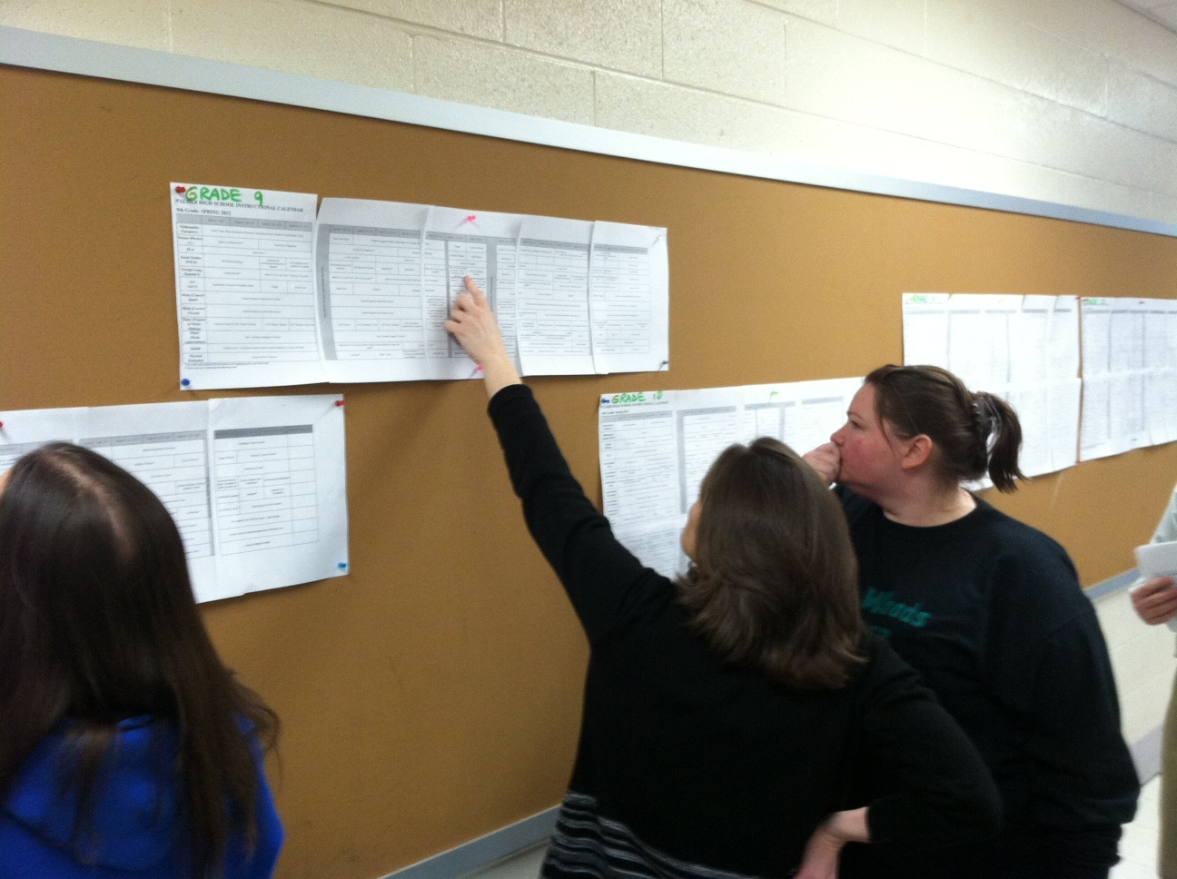

Slide 27
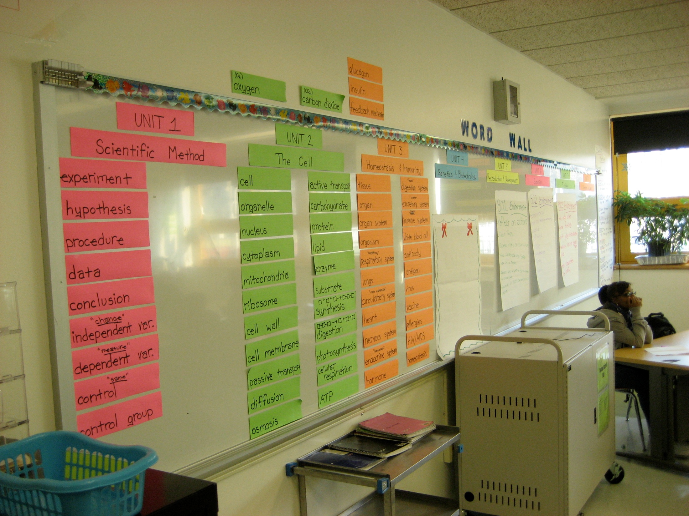

Slide 29
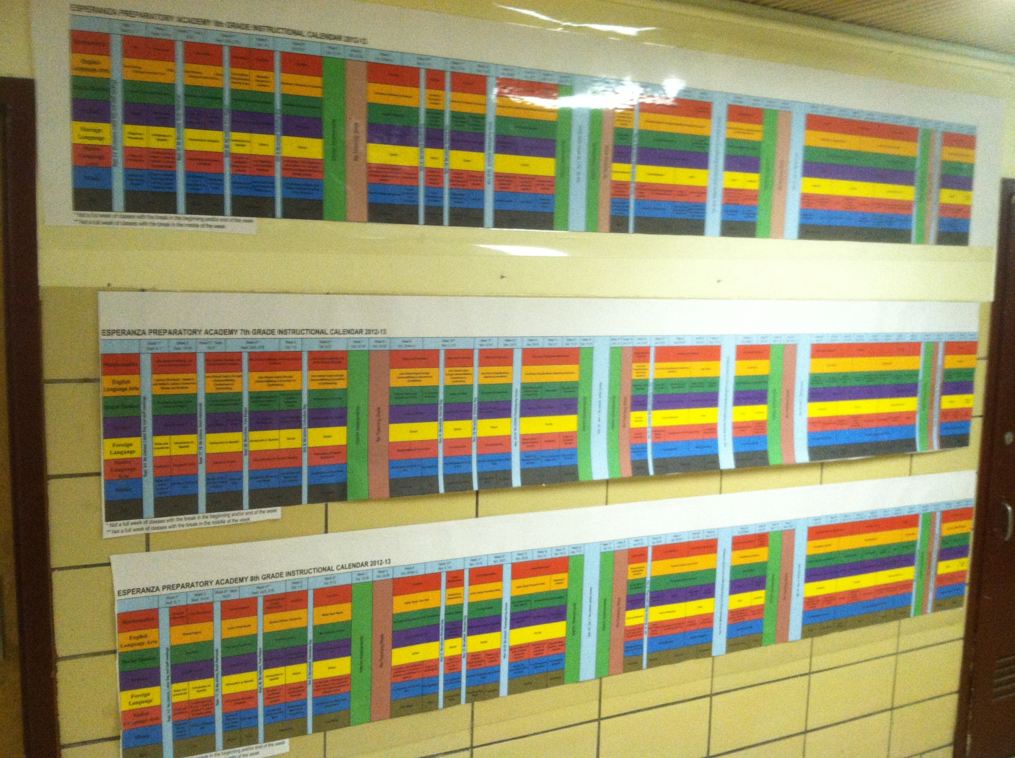

Slide 30
C. Setting long-term, SMART goals
Looking ahead 4 years
What levels of proficiency do we want by then?
Set an ambitious but realistic target
Set SMART goals by team each fall: Specific, Measurable, Attainable, Results-oriented, Timebound

Slide 31
A goal is a dream with a deadline.
Napoleon Hill

Slide 32

Set in 2001

Slide 33
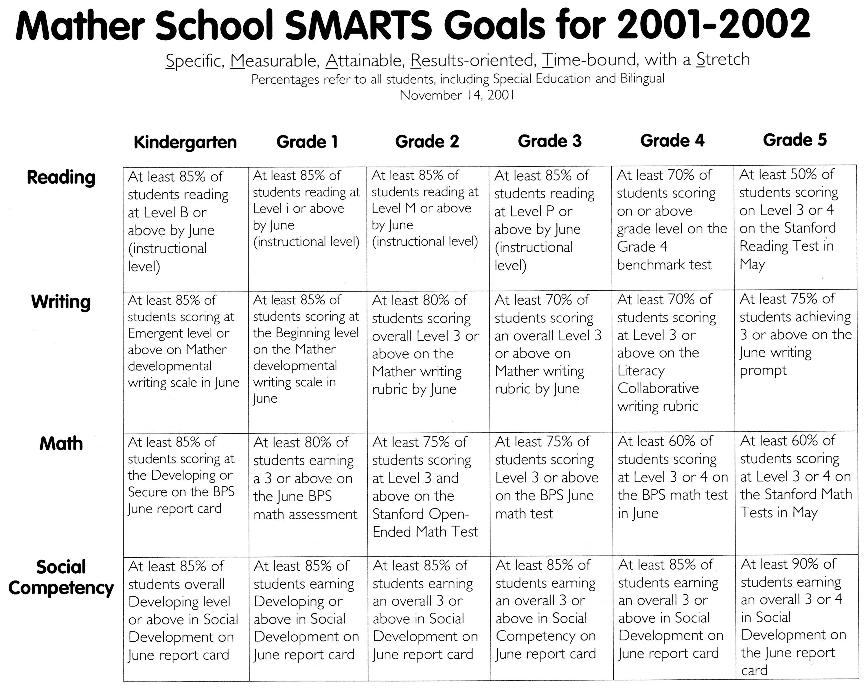

Slide 34
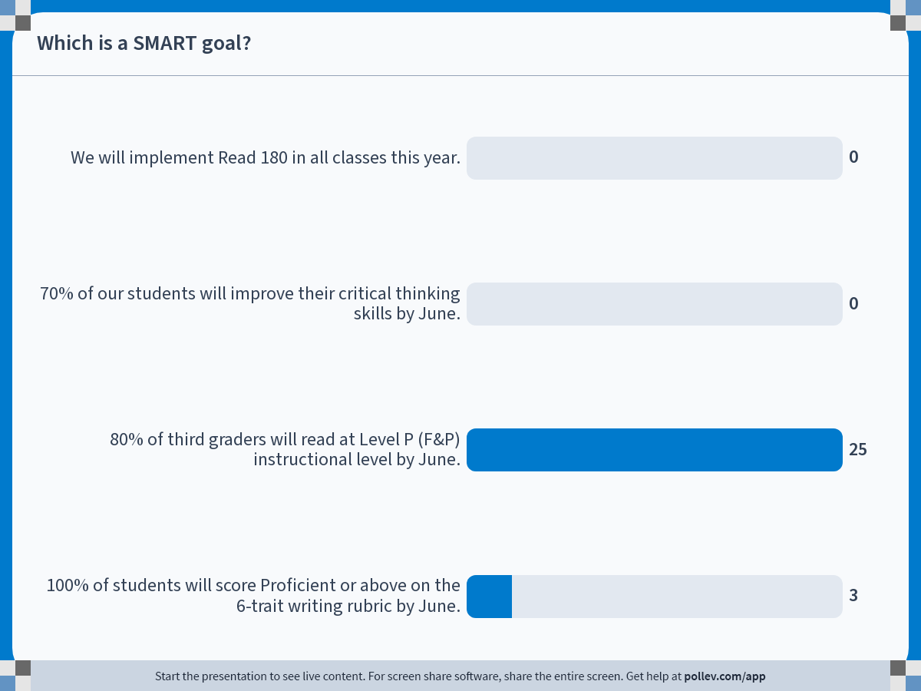
Notes:
Which is a SMART goal?
https://www.polleverywhere.com/multiple_choice_polls/I0YzSnWMPDzGH14iuYsQo?flow=Default&onscreen=persist

Slide 35
D. Getting good interim assessments
Aligned with rigorous state standards and tests
Common, aligned with curriculum sequence
High-quality items, including writing
“Goldilocks” length - not too long, not too short
Diagnostic (especially up front in September)
Reassess previously-taught skills and knowledge
Performance tasks, projects, performances
Achievement Network does good work.

Slide 36
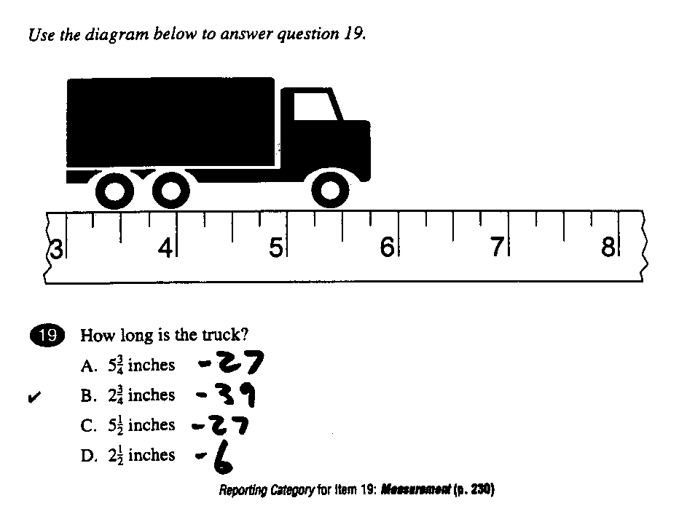
Using multiple-choice items well

Slide 37
Which fraction is largest?
2/1 3/8 4/3

Slide 39
Rigor level is determined by the question
All these test items measure the same math standard:
Identify 50% of 20
Identify 67% of 81
Shawn got 7 correct out of 10 possible answers on his science test. What percent of questions did he get correct?
J.J. Redick was on pace to set an NCAA record in career free-throw percentage. Leading into the NCAA tournament in 2004, he made 97 of 104 free-throw attempts. What percentage of free throws did he make?

Slide 40



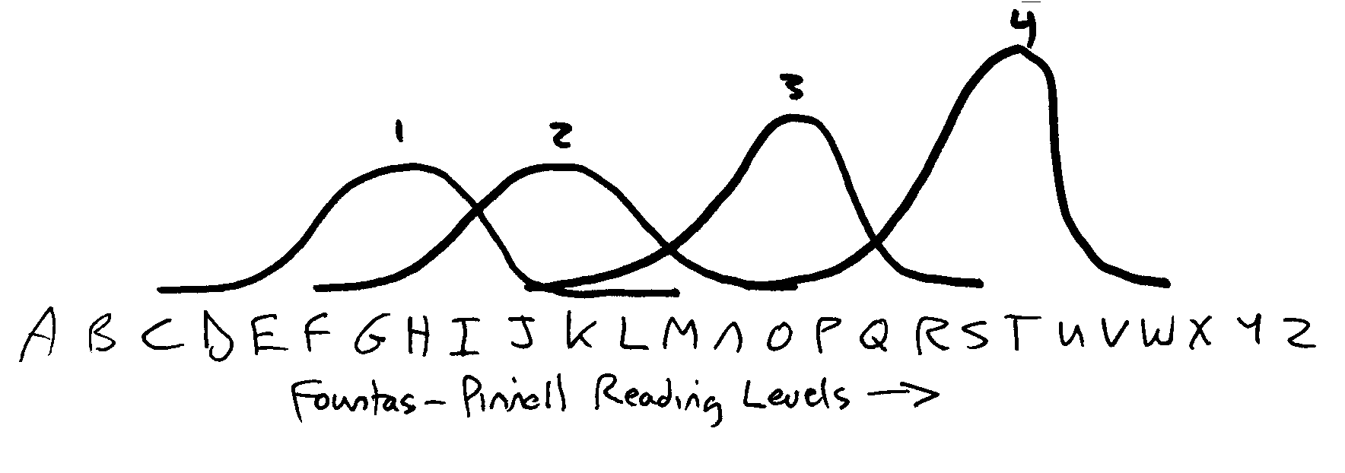
Four kinds of interim assessments

Slide 41
Scheduling assessments, follow-up
Assessments need to be in people’s calendars.
An August task, for first staff meeting
  Interim assessments timing
  Teacher scoring time
  Team data meetings
  Action planning
  Re-teaching days (GNA schedule)
Building in rapid turnaround is essential! What does it say?
Sept. Oct. Nov. Dec. Jan. Feb. Mar. Apr. May June

Slide 42
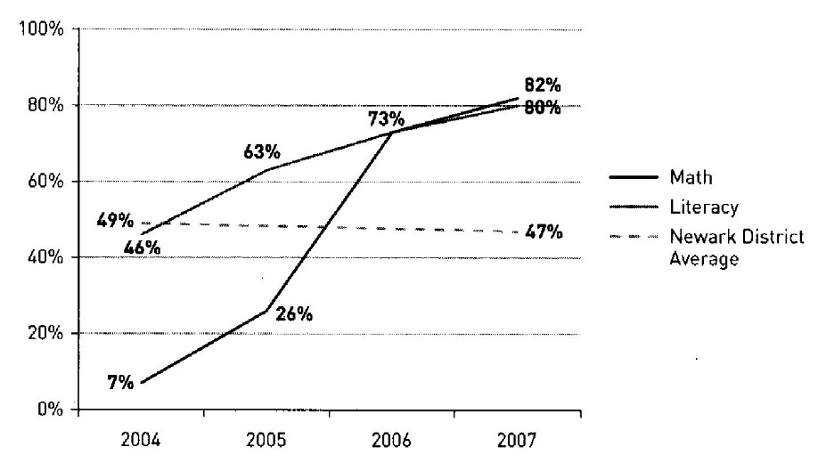
Greater Newark Academy schedule, results
Every 9 weeks:
  Wednesday and Thursday – interim assessments
  Friday – early dismissal, scoring, analysis, planning
  Monday and Tuesday – re-grouping, re-teaching

Slide 43
F. Teacher scoring and analysis
Worst-case scenario: “We send it to the office.”
Need to get ownership, understanding
“All hands on deck” approach
Collegial scoring helps understanding, efficiency
Scanning multiple-choice items if possible
But low-tech works too…

Slide 44
G. Effective data display
According to Robert Marzano’s book,
  Classroom Assessment and Grading That Work
Second-most powerful factor
Effective display of ongoing achievement data
.70 effect size!
But what makes a display effective?

Slide 45
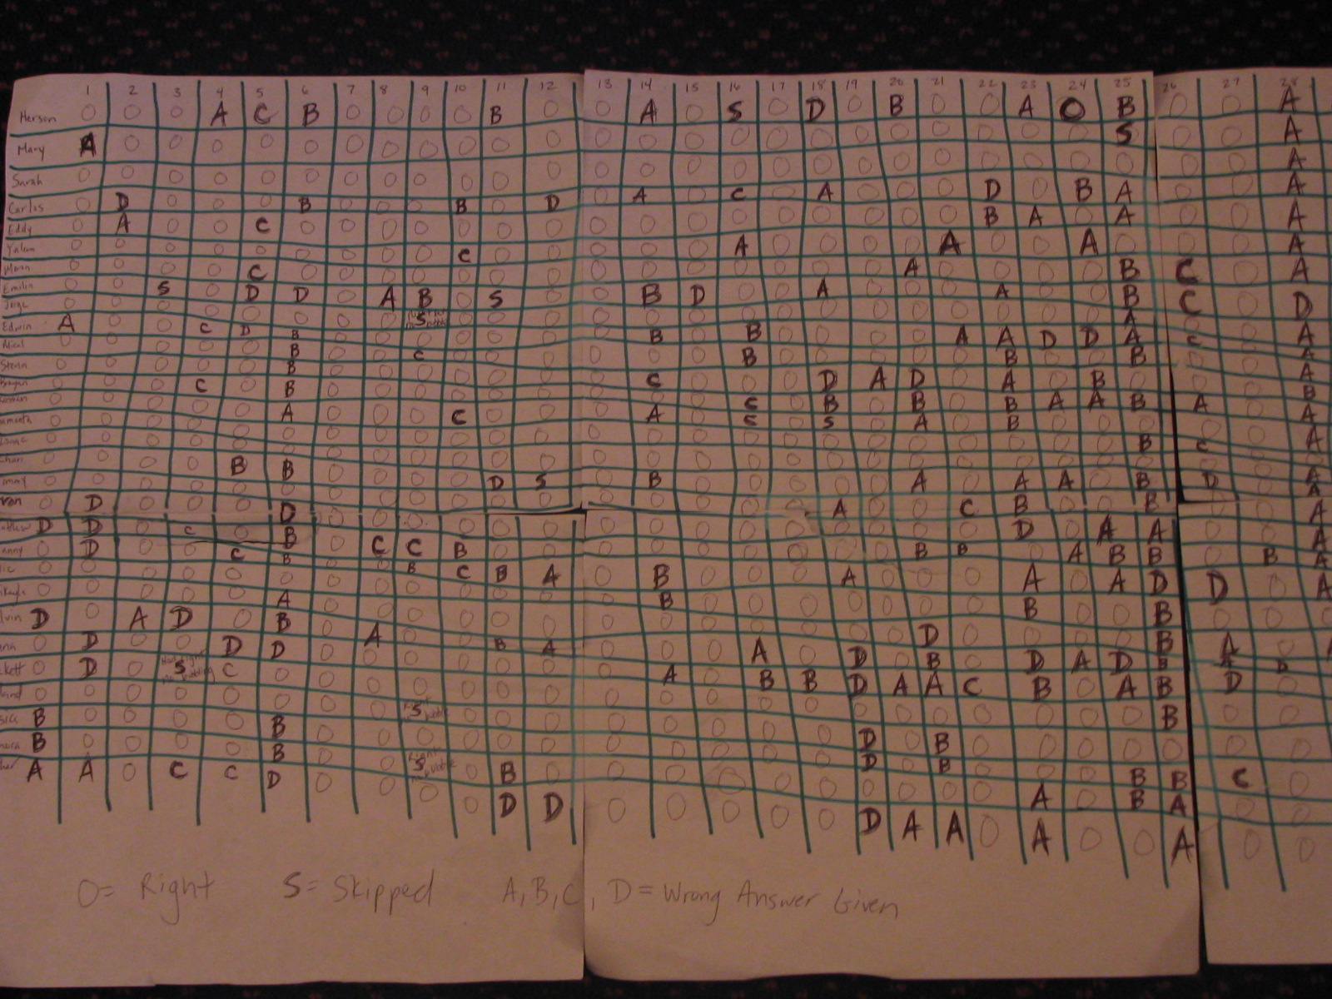

Slide 46
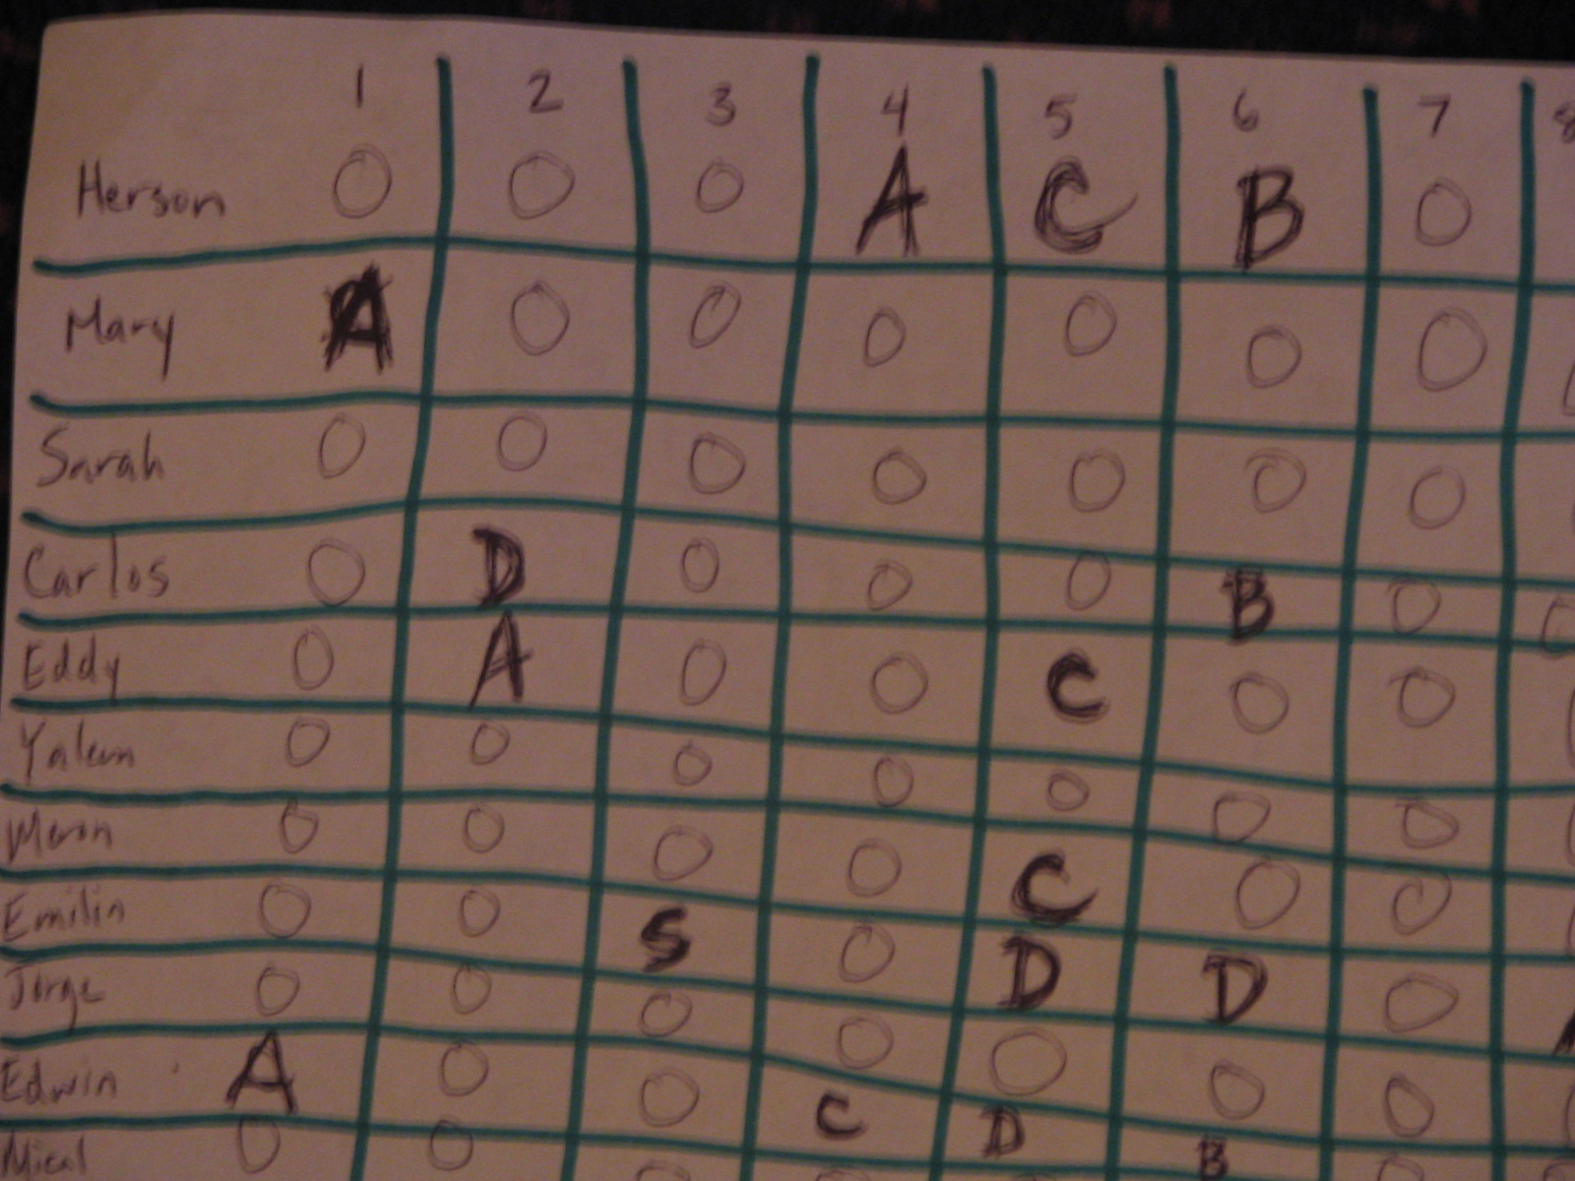

Slide 48
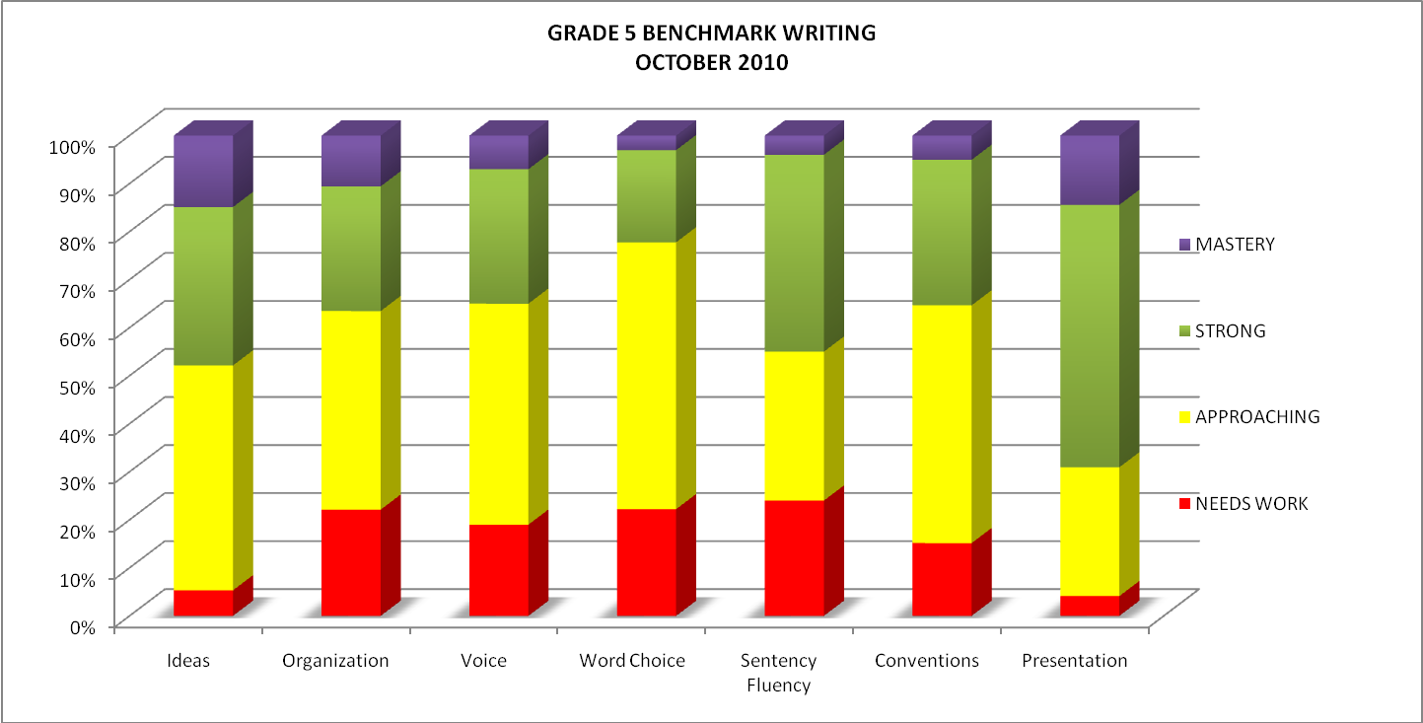

Slide 49
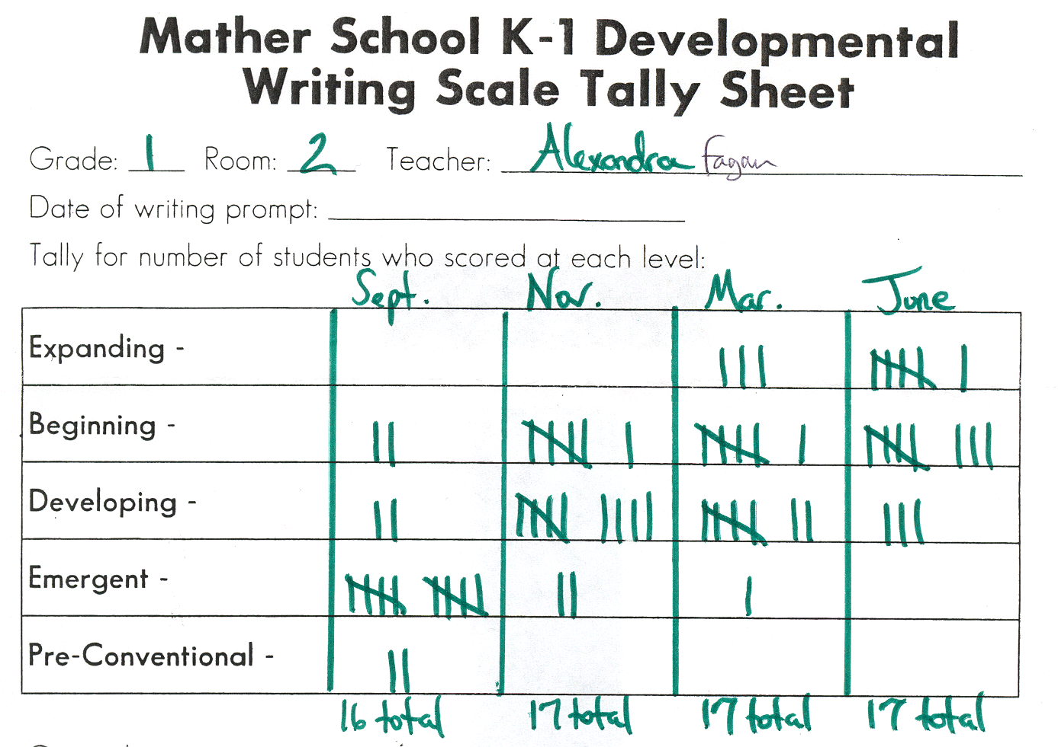

Slide 50
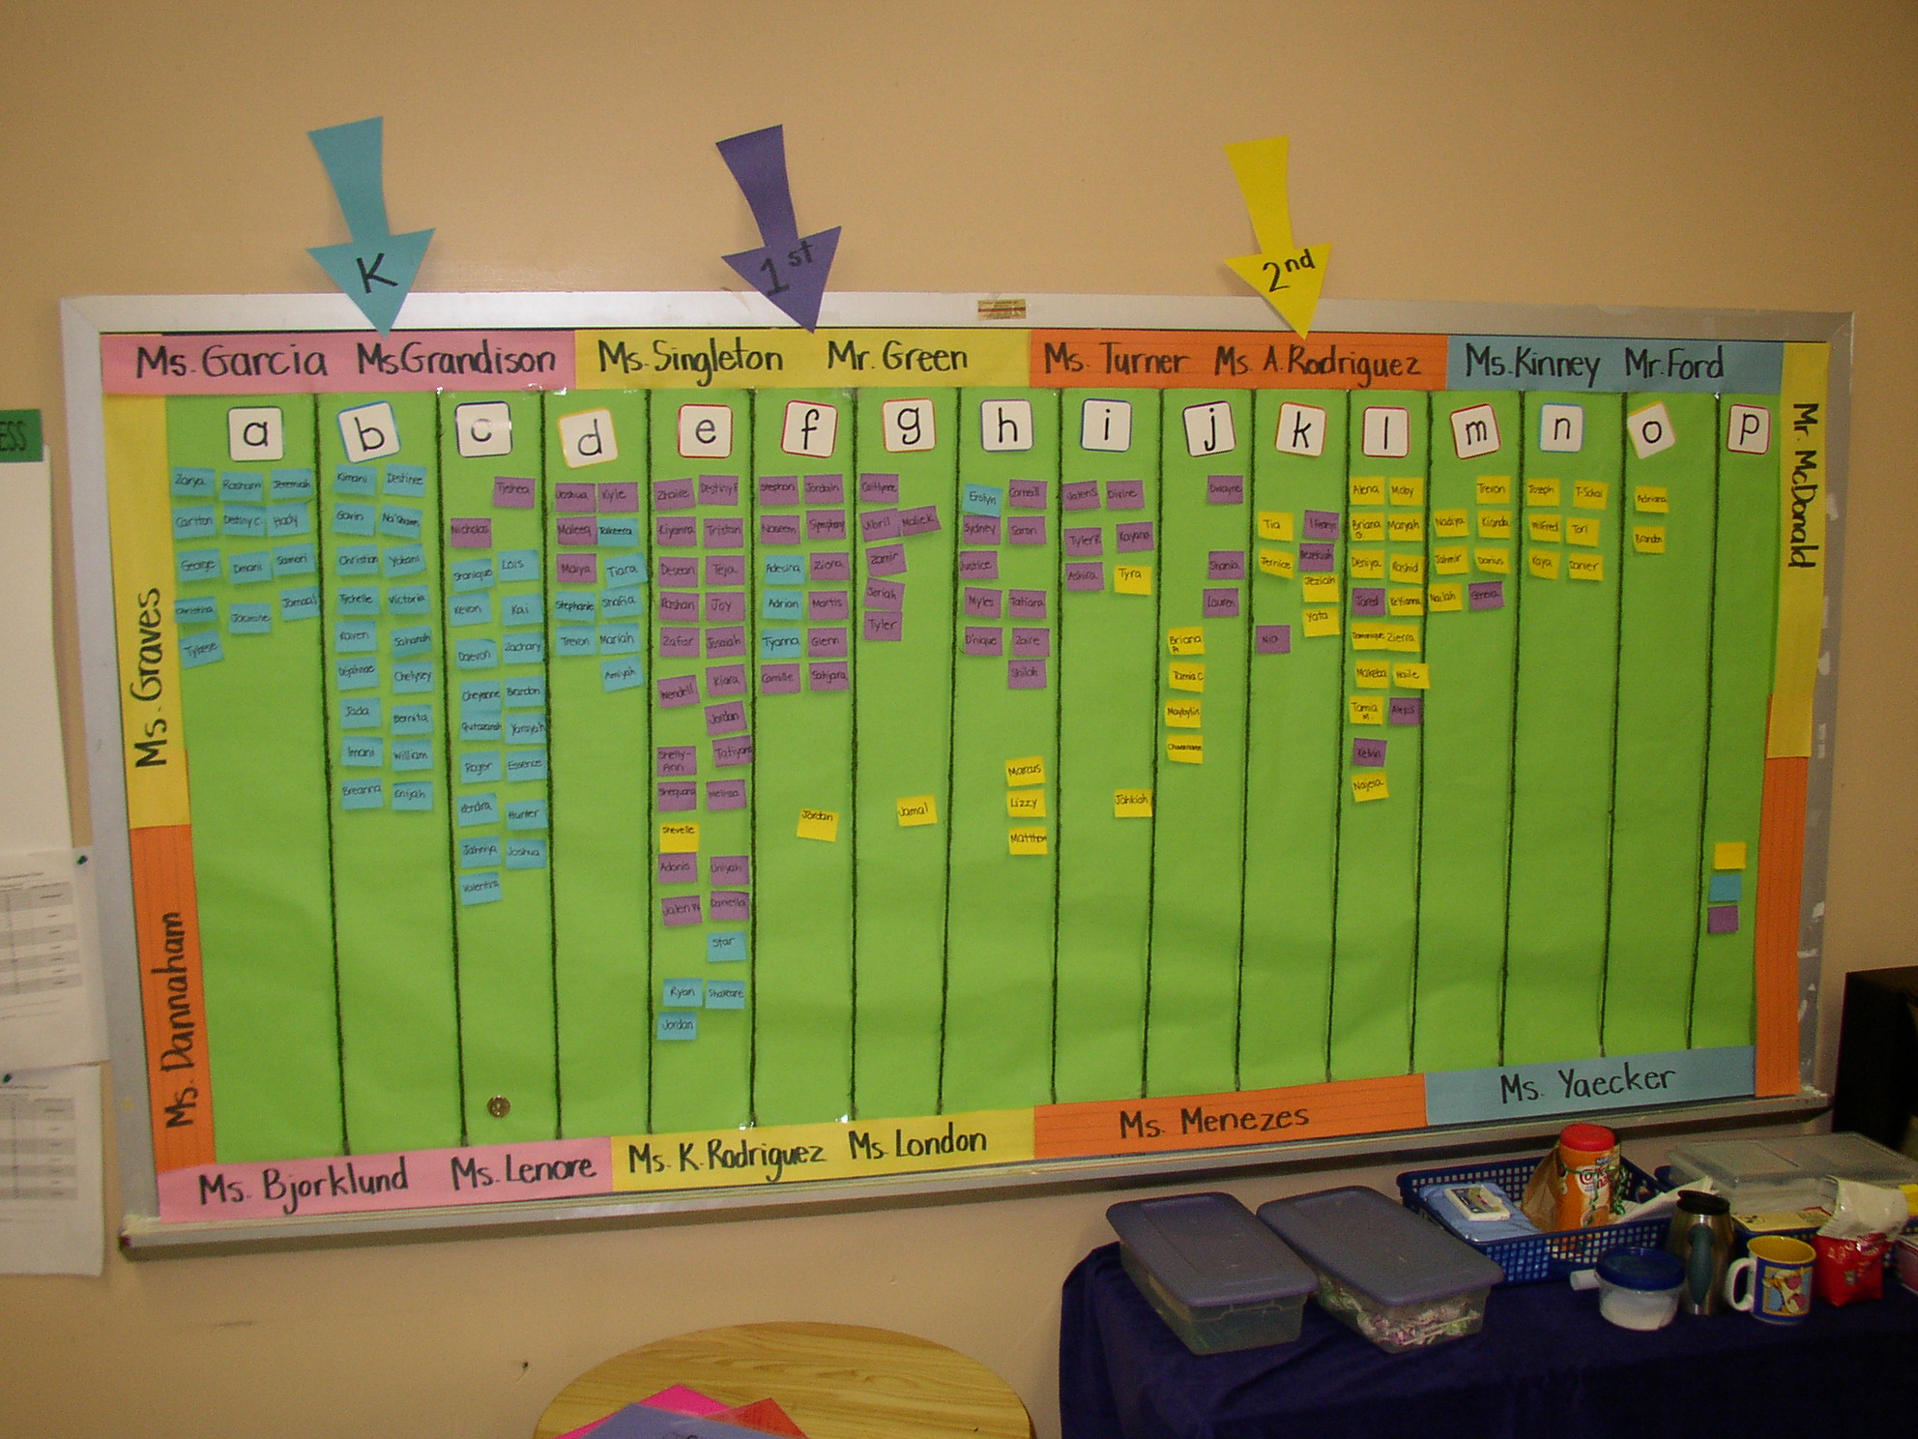

Slide 51
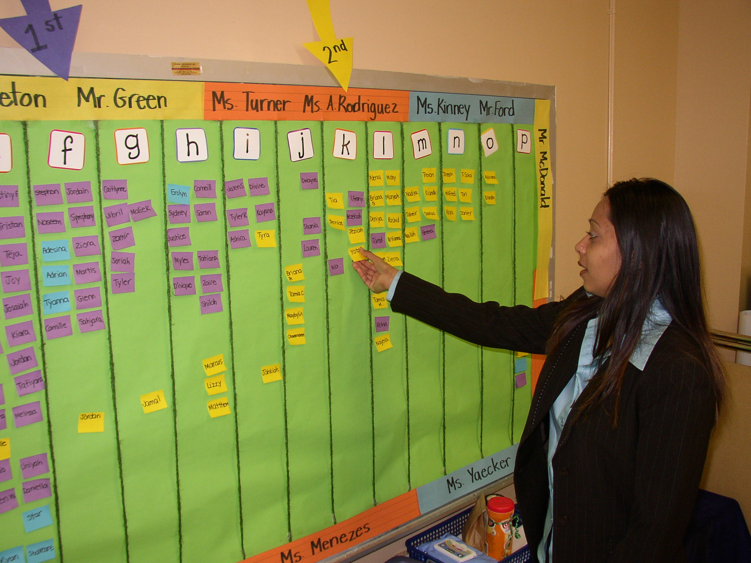

Slide 52
H. Data meetings, action planning
Without action, it’s data for data’s sake!
Same-grade, same-subject teams
The key role of an instructional coach or facilitator
Test in hand
Error analysis on the lowest-scoring items
Asking why didn’t the kids get it
Low-stakes: it’s OK to admit error, share successes
  “How are you getting such good results?”
Singleton teachers: Zoom!

Slide 53
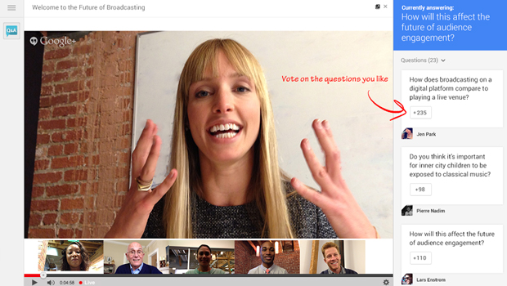
Zoom, Google Hangouts

Slide 54
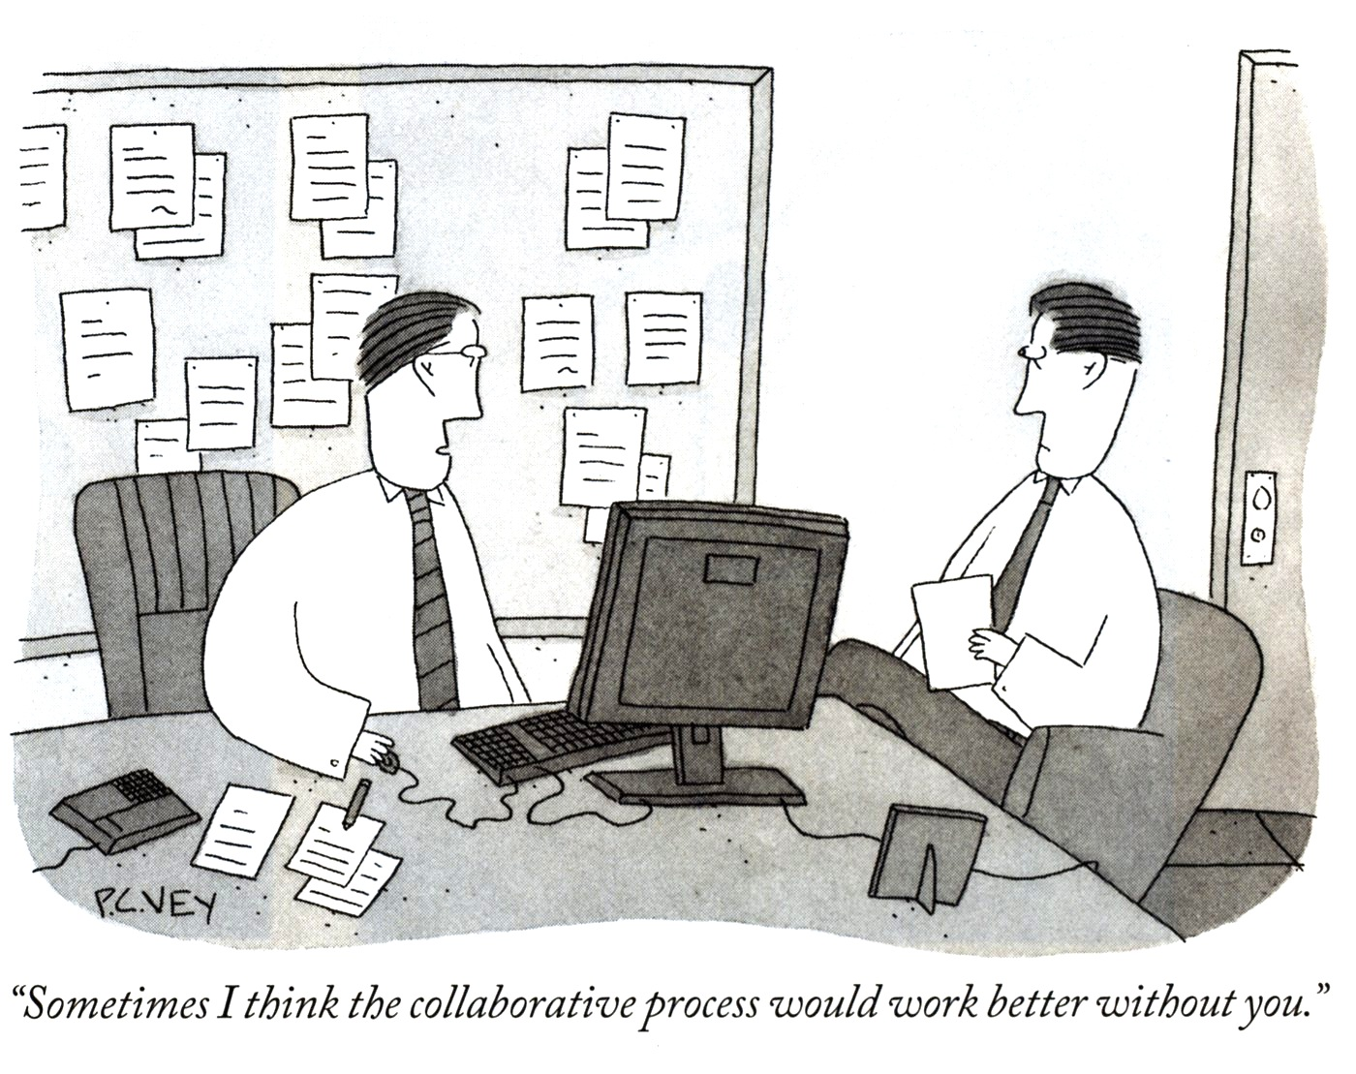

Slide 55


Slide 56
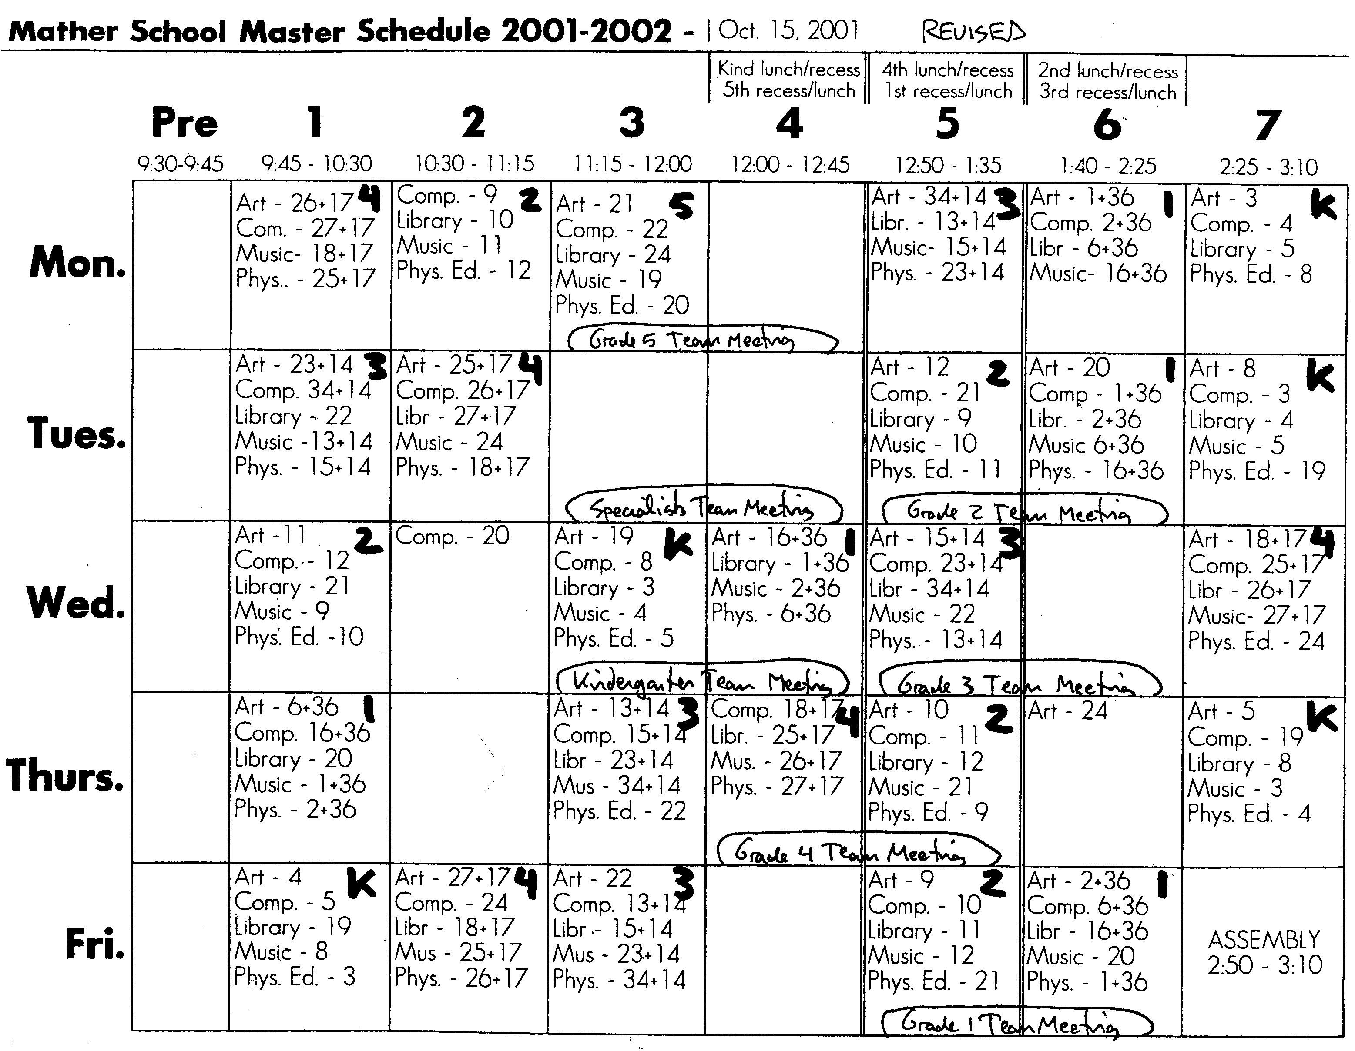

Slide 57

Your kids did better than mine. What did you do?

Slide 58
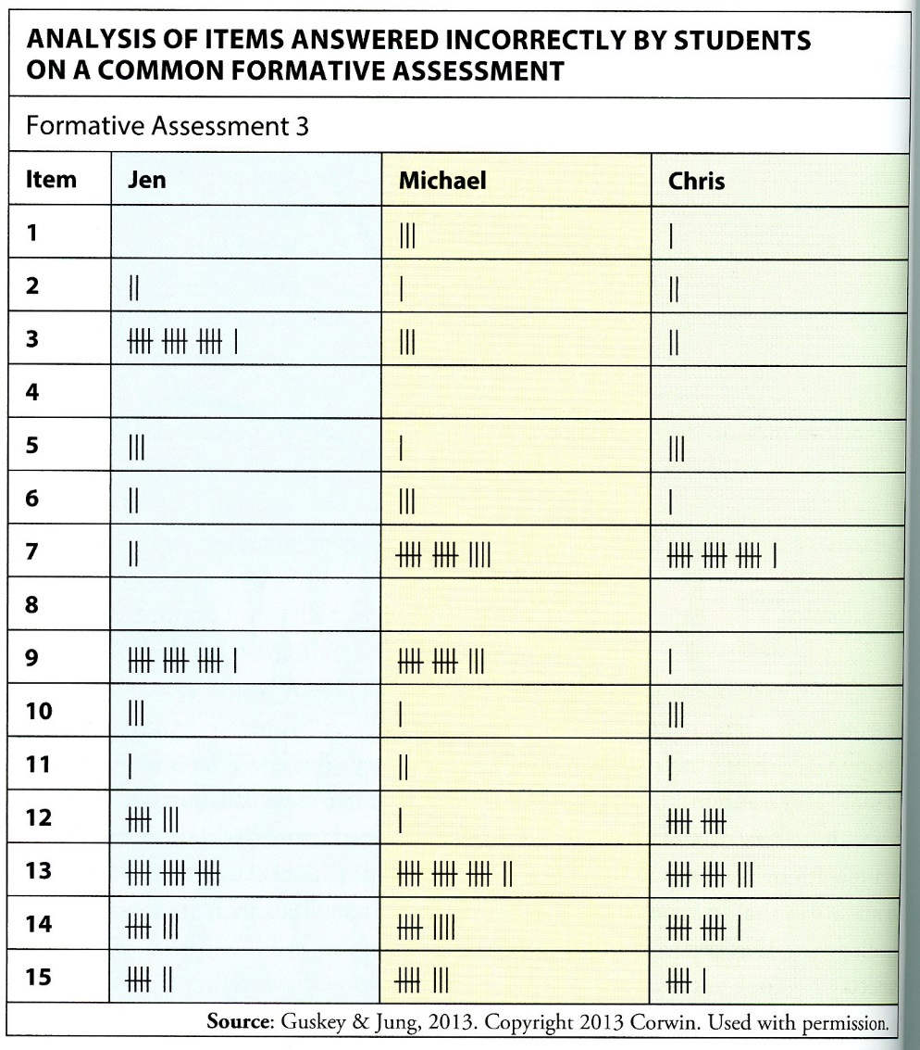

Slide 59
Prerequisites for effective team data work
Teaching the same curriculum as the same time
Giving common, high-quality assessments
Prompt scoring and item analysis
Enough time to meet and discuss
Trust and humility among team members
Student data and the actual test items in hand
Each teacher’s results visible to the team
Frank discussion of what worked, what didn’t, and why
Prompt follow-up with struggling students

Slide 60
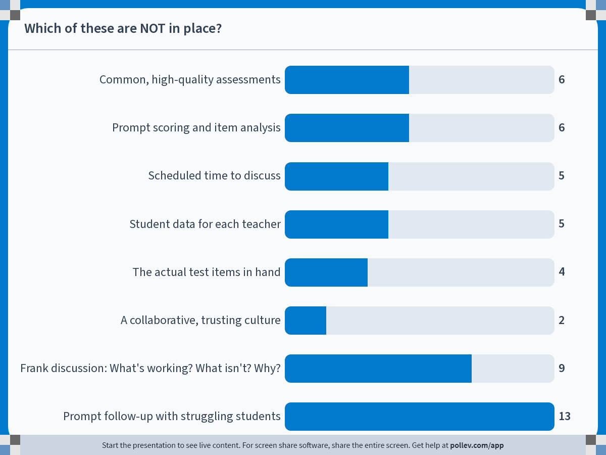
Notes:
Do not modify the notes in this section to avoid tampering with the Poll Everywhere activity.
More info at polleverywhere.com/support
Which of these are NOT in place?
https://www.polleverywhere.com/multiple_choice_polls/S1U8WMx6r2wZcq69ltvBZ?state=opened&flow=Default&onscreen=persist

Slide 61
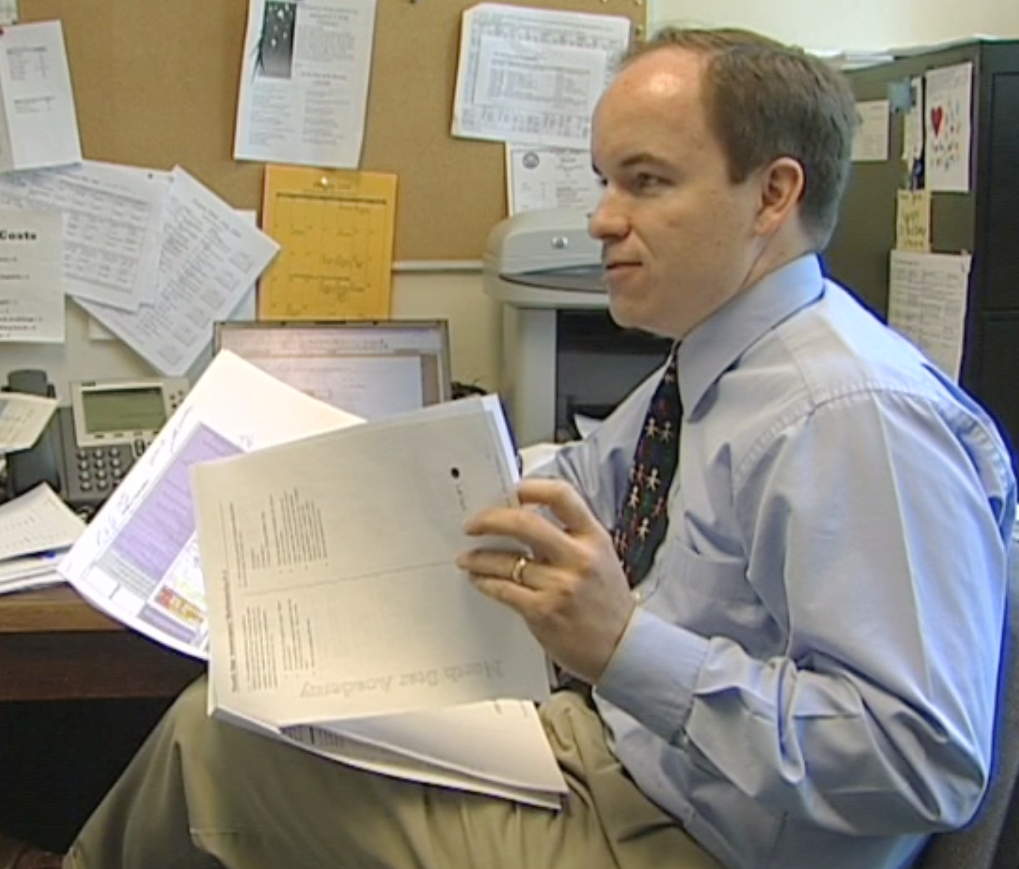
Paul Bambrick-Santoyo

Slide 62
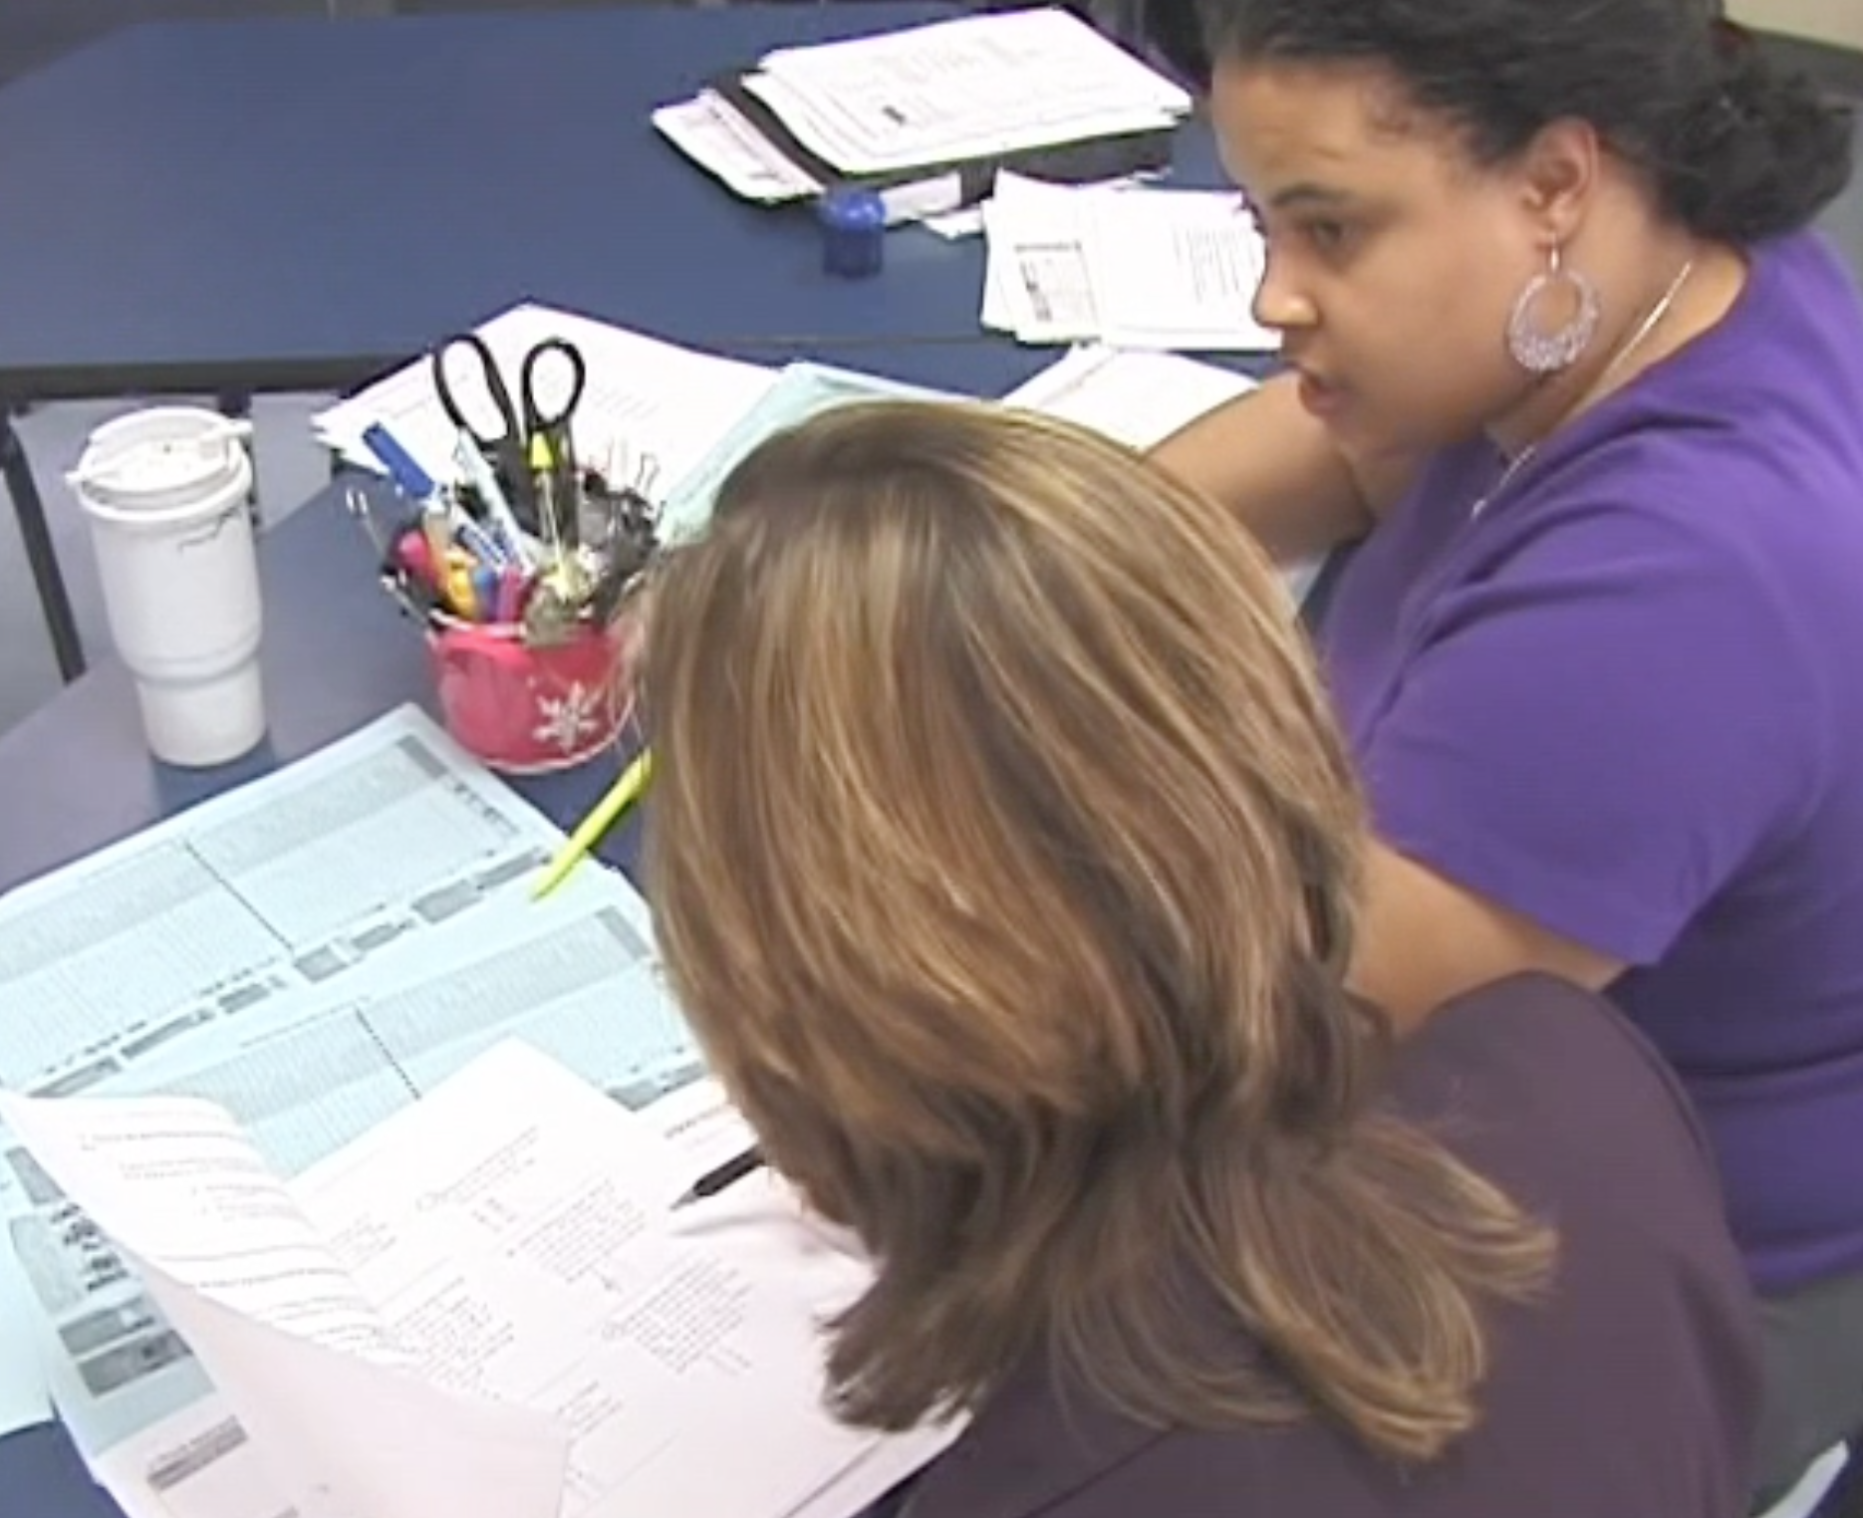

Slide 63
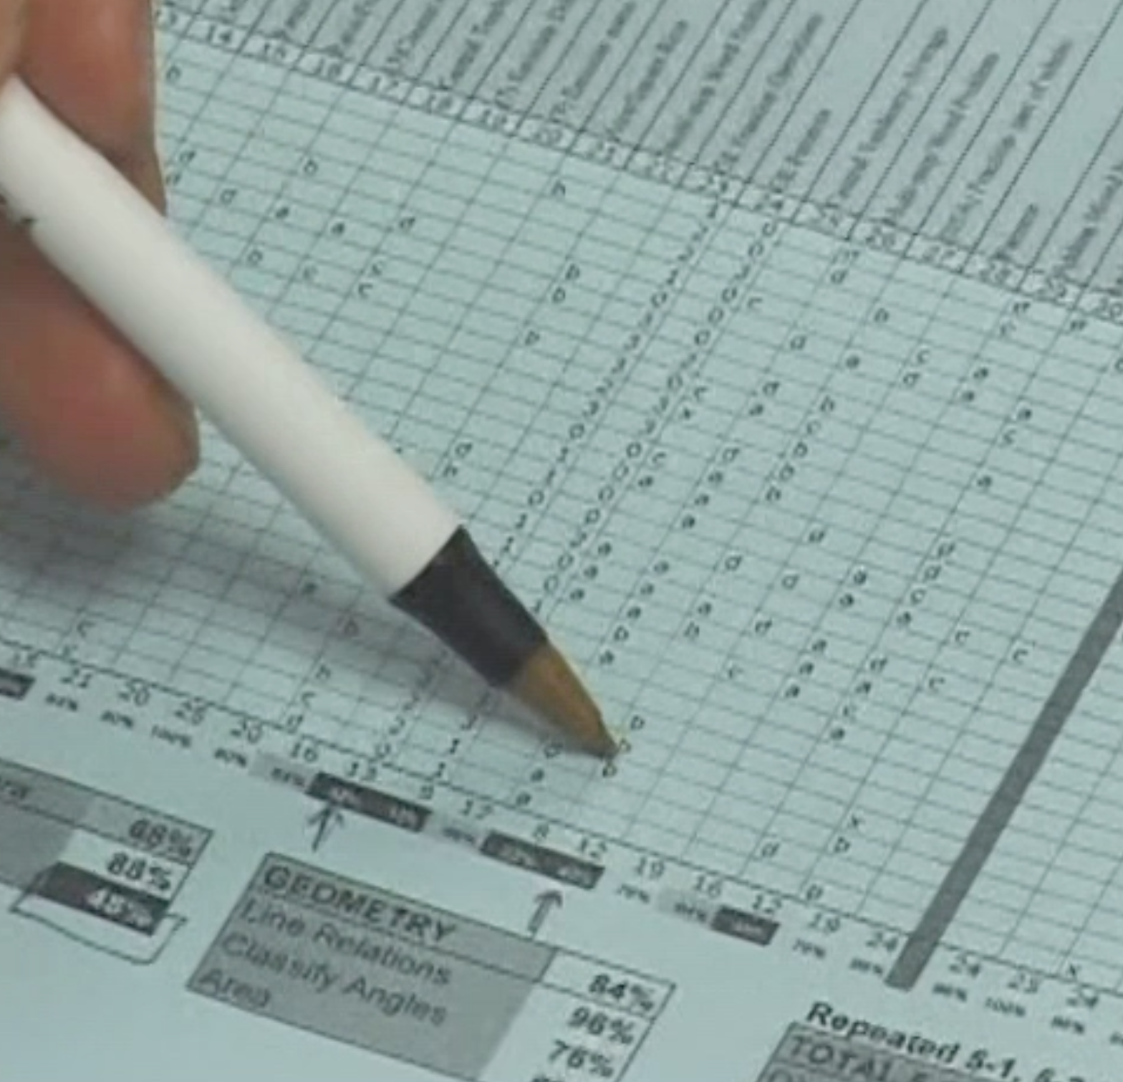

Slide 64
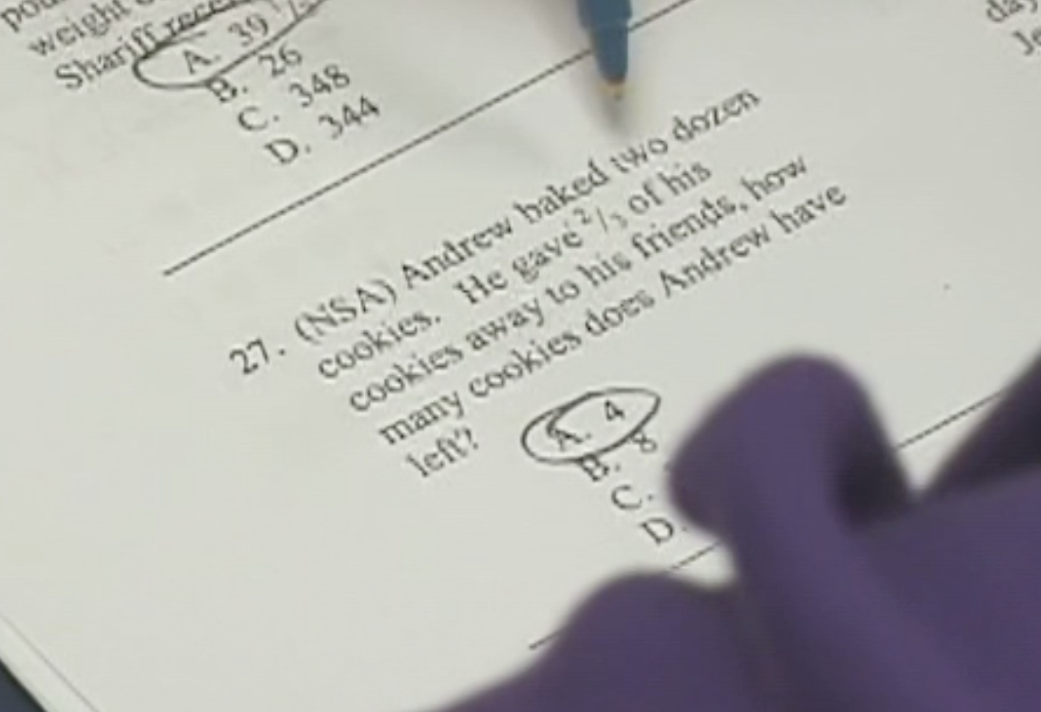

Slide 65
I. Involving students
Kids having a goal (e.g., reading at F/P level T by June)
Knowing their current status (I’m at Q now)
Developing a strategy
Medium stakes: not “gripping the bat too hard”
Teachers sensitive to “stereotype threat”
MOTIVATED! INVESTED! DETERMINED!

Slide 66
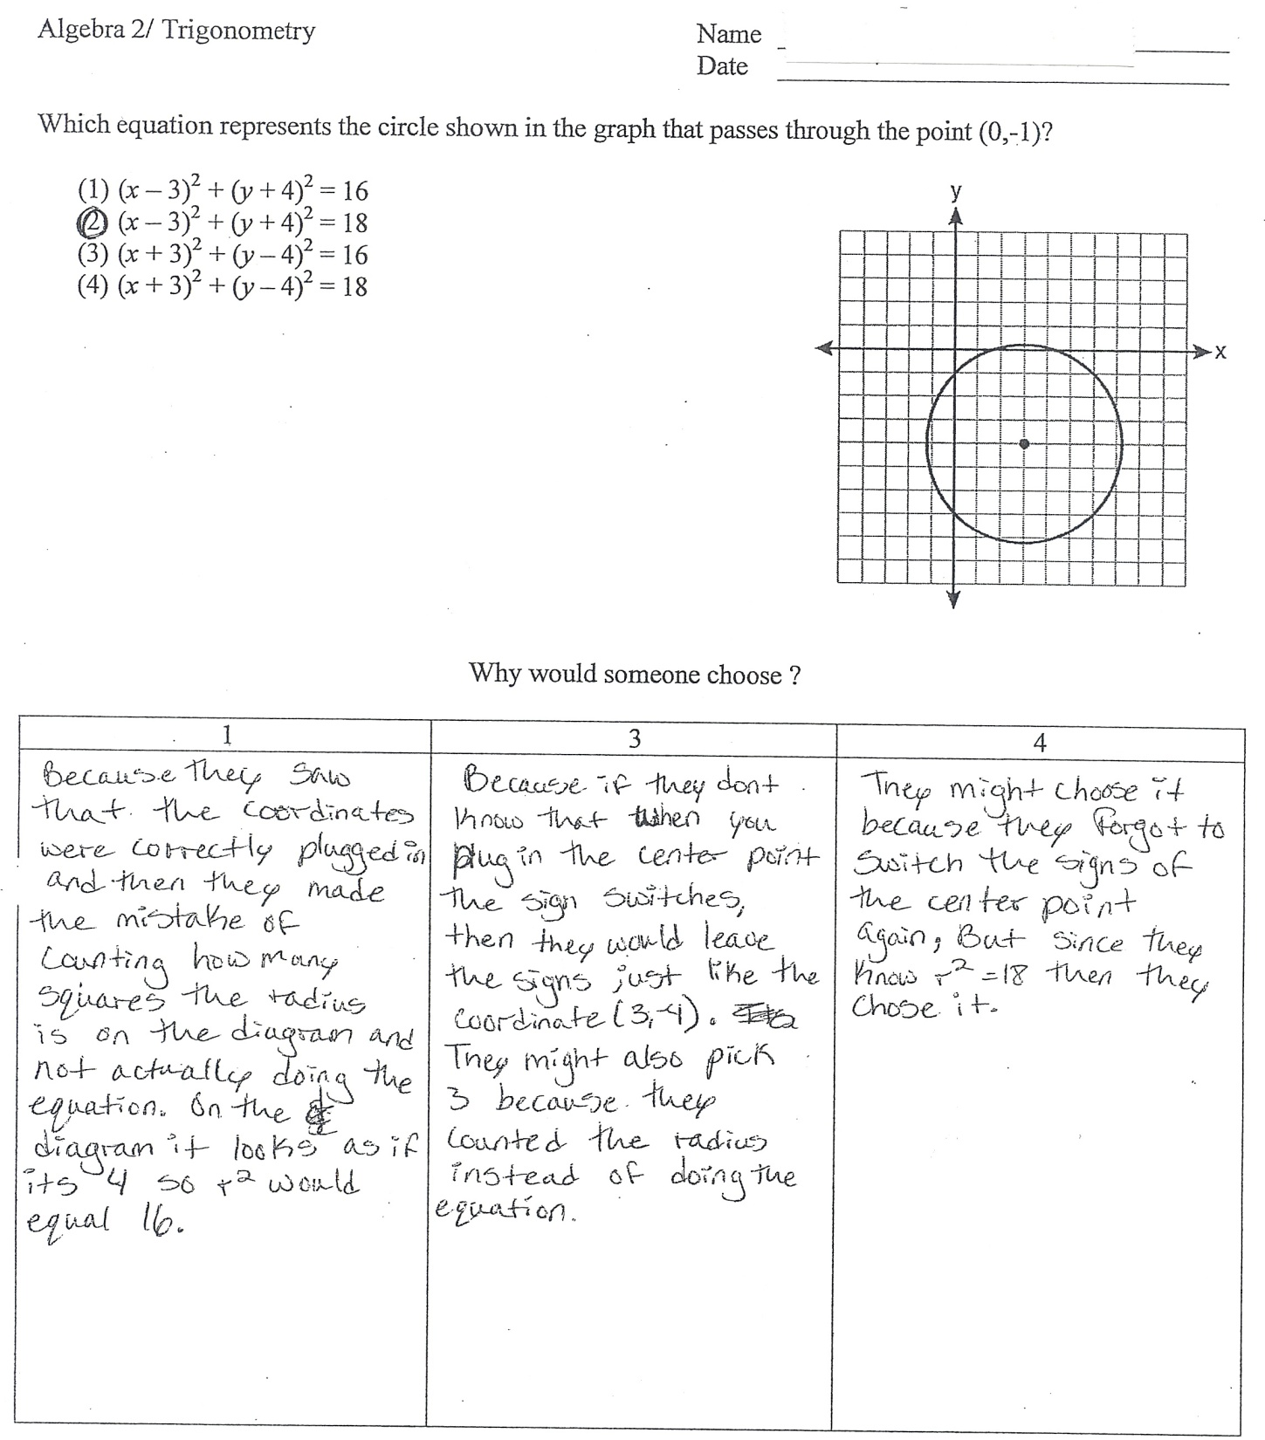

Slide 67


Slide 68
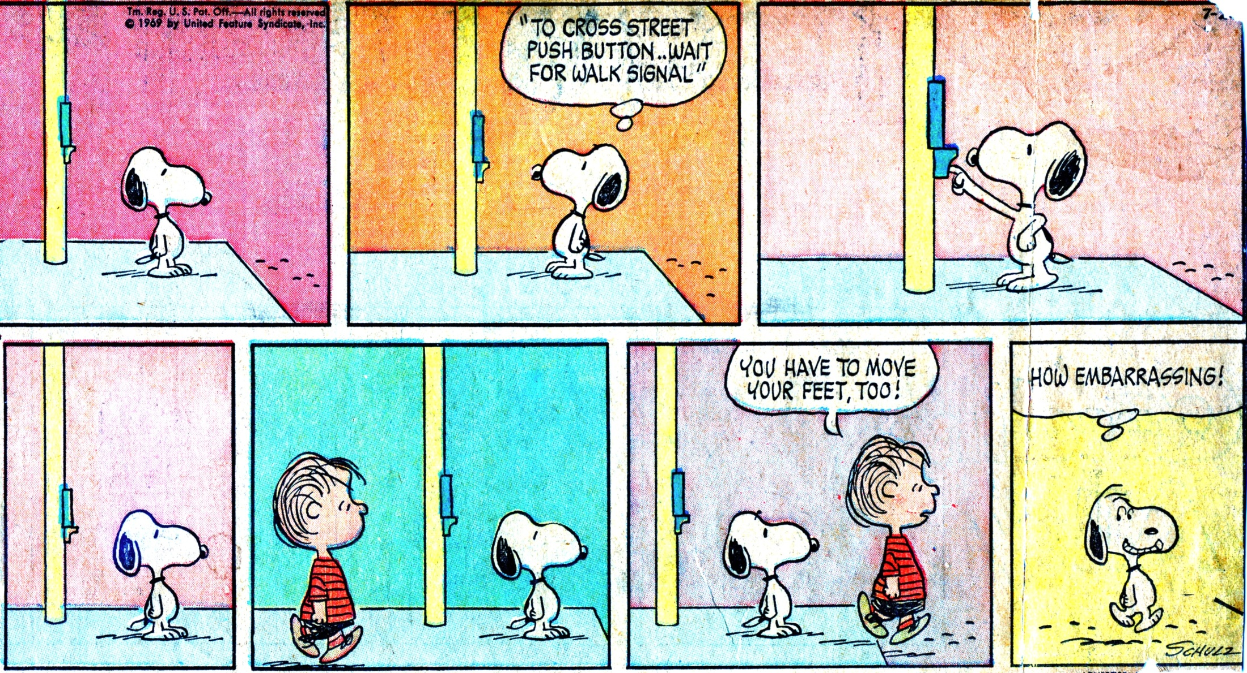
J. Relentlessly following up

Slide 69
Just having data won’t change a thing
“There’s confusion among people about a measurement tool and an intervention.”
  Eric Finkelstein 2016
An author tracking Amazon rankings on a book
• The response must be rapid, attuned to needs, and non-negotiable

Slide 70
A team’s report after a PLC meeting
The objective or goal we addressed (e.g., students mastering the Pythagorean theorem)
The assessment or student work we looked at
The students who need help – by name and need
Students who need enrichment
Insights about how to teach this most effectively

Slide 71
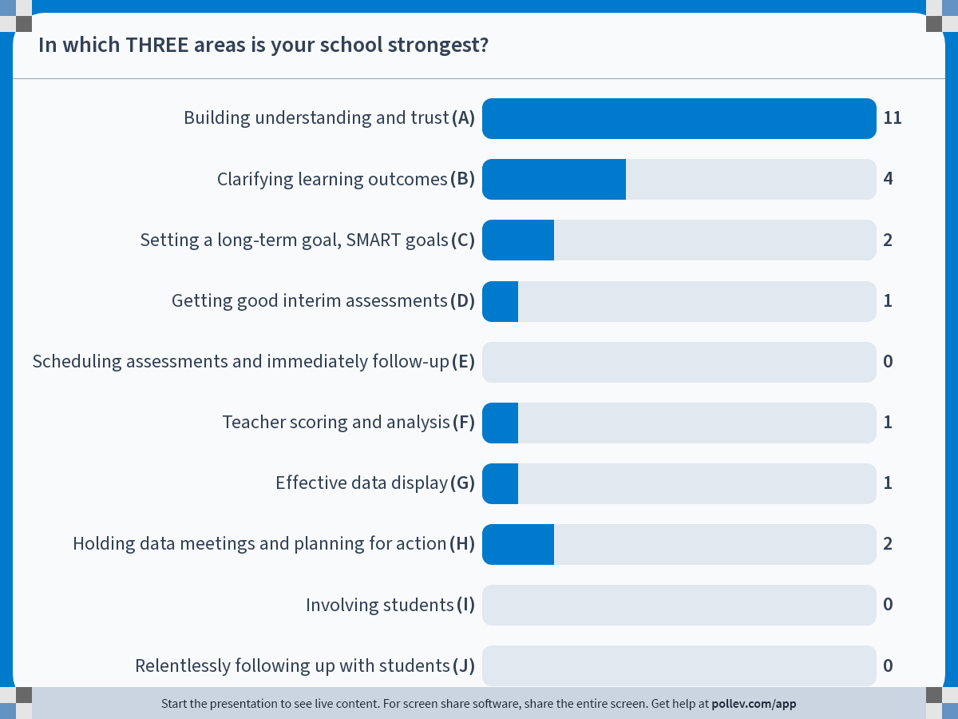
Notes:
In which THREE areas is your school strongest?
https://www.polleverywhere.com/multiple_choice_polls/19td8oYhbV9r8c9FOlvR1?flow=Default&onscreen=persist

